Slide 1
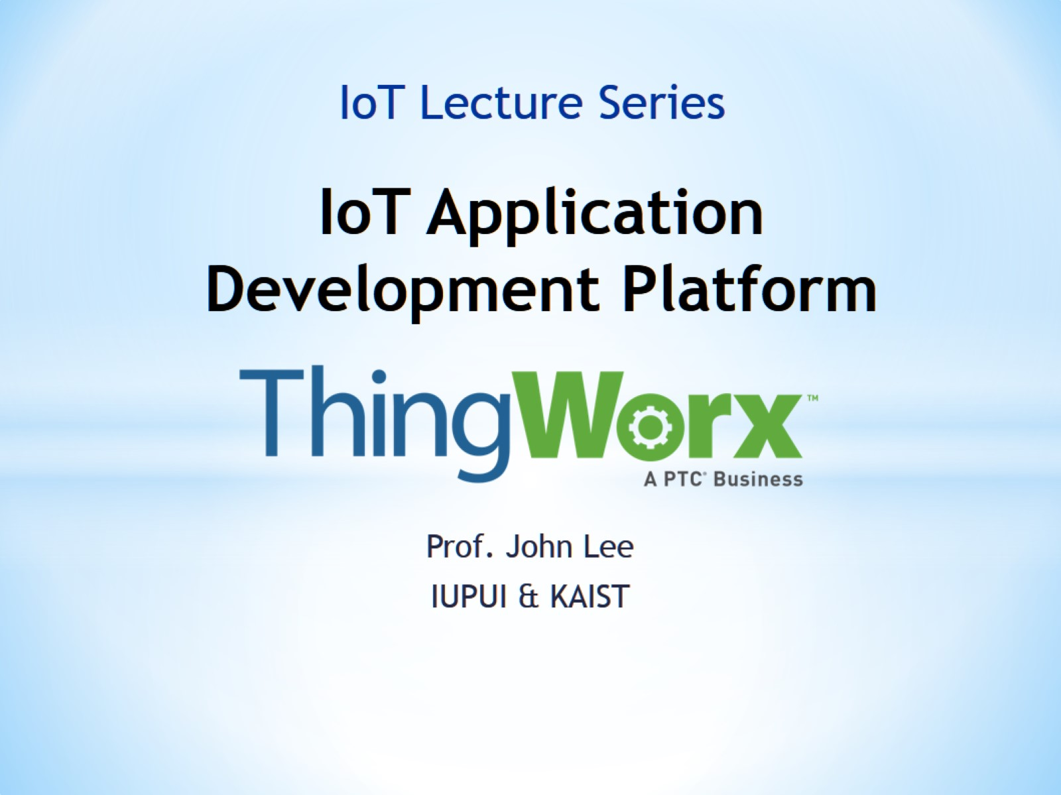
IoT Application Development Platform

Slide 2
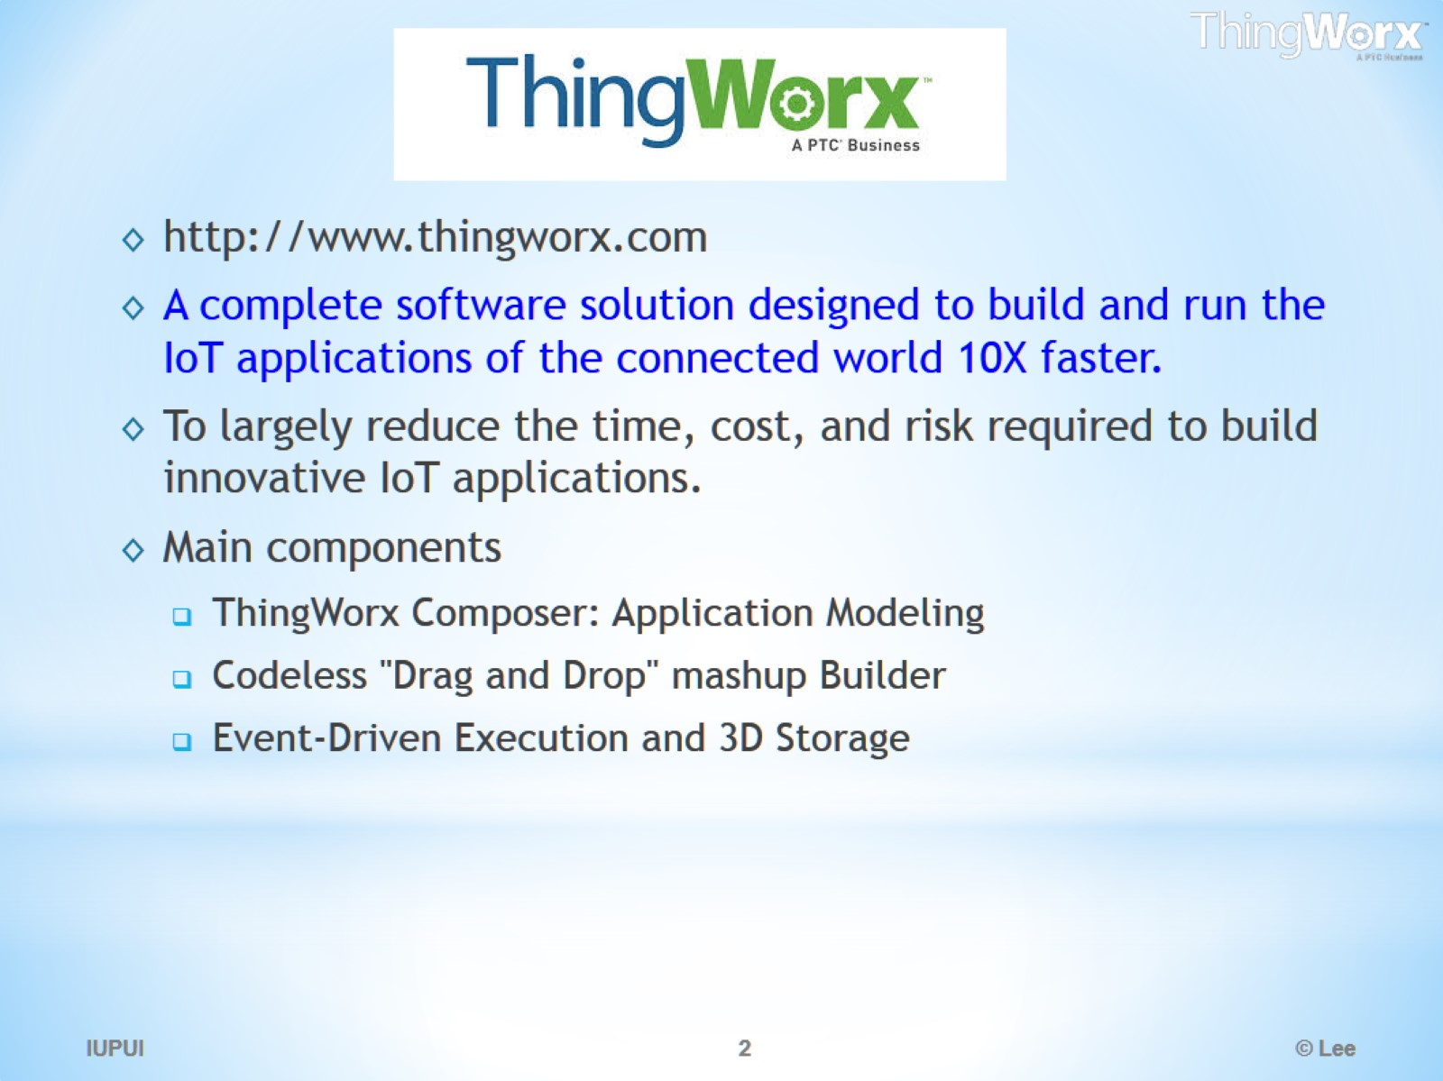

Slide 3
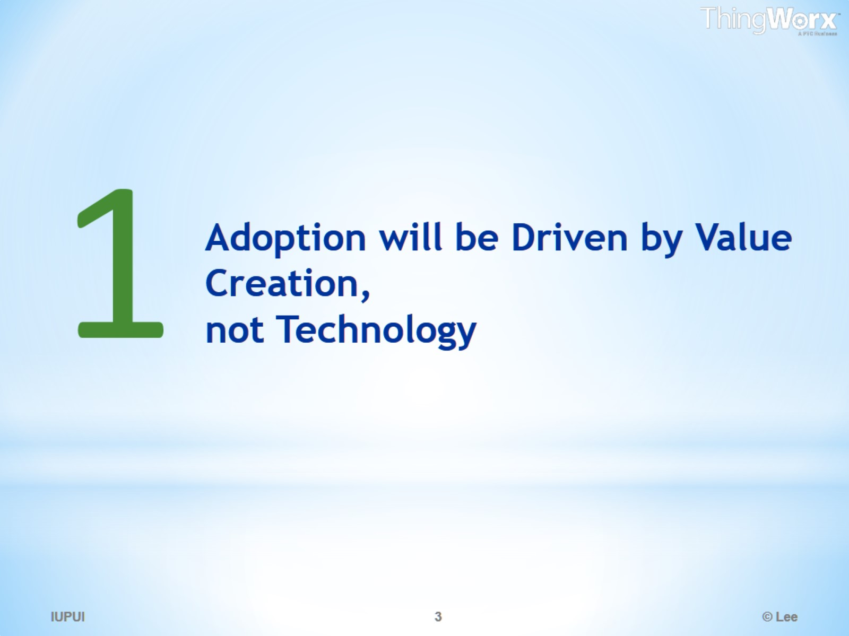
Adoption will be Driven by Value Creation, not Technology

Slide 4
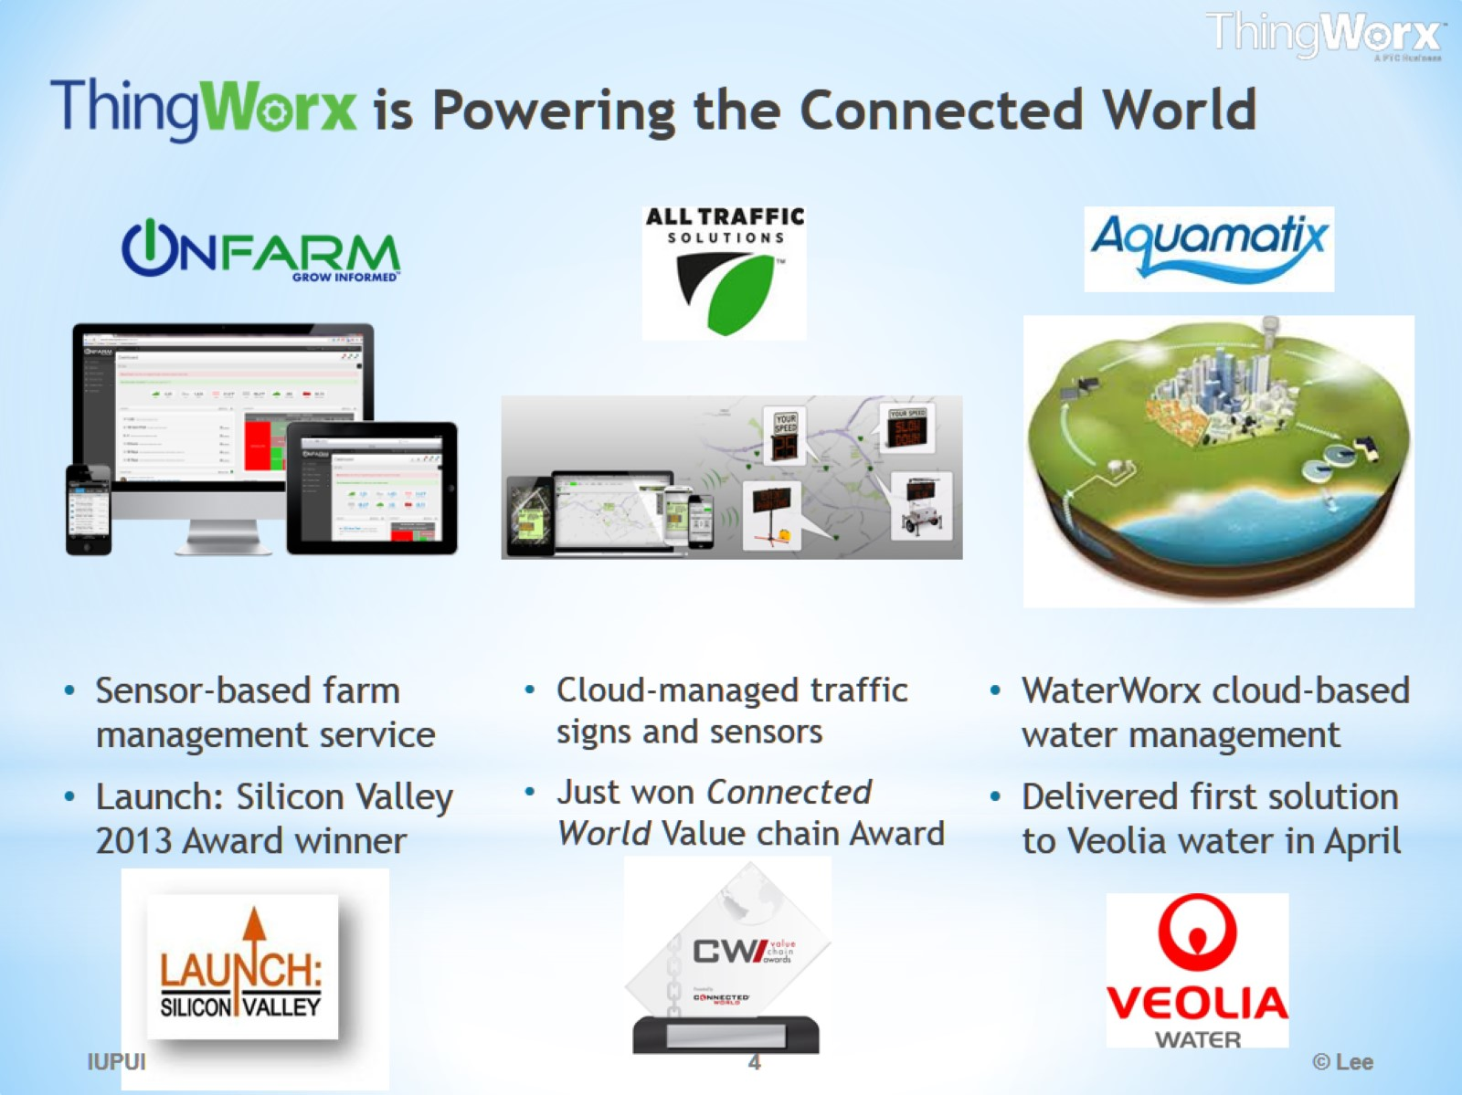
is Powering the Connected World

Slide 5
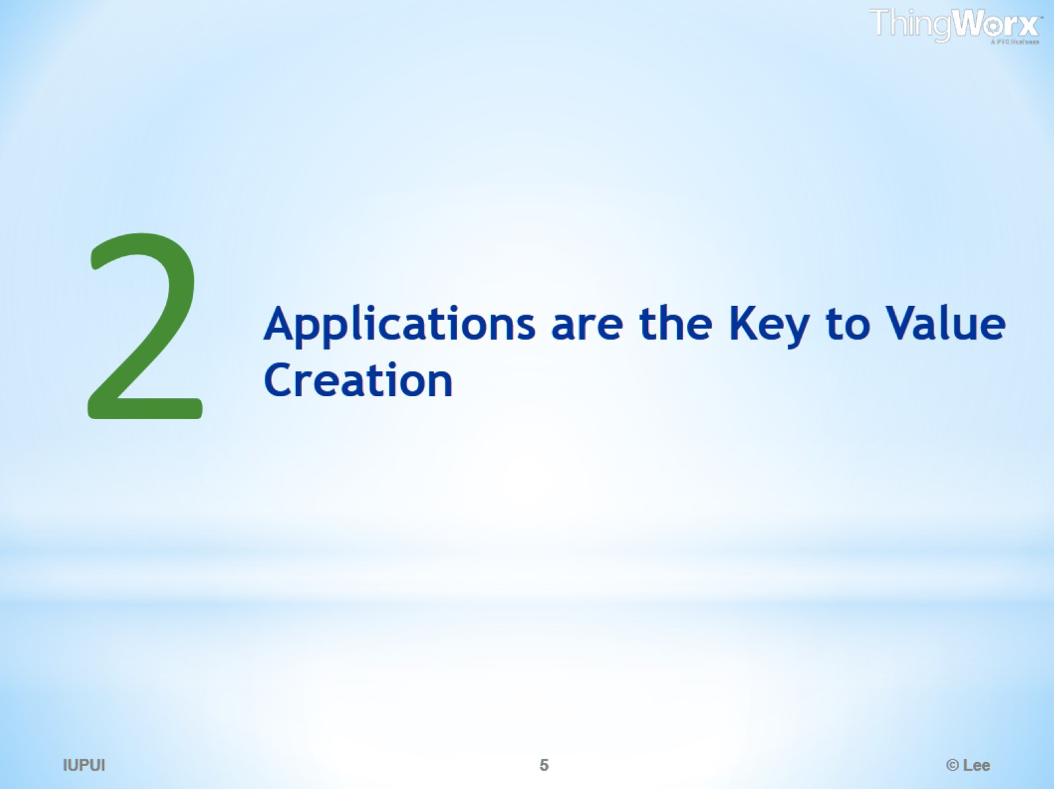
Applications are the Key to Value Creation

Slide 6
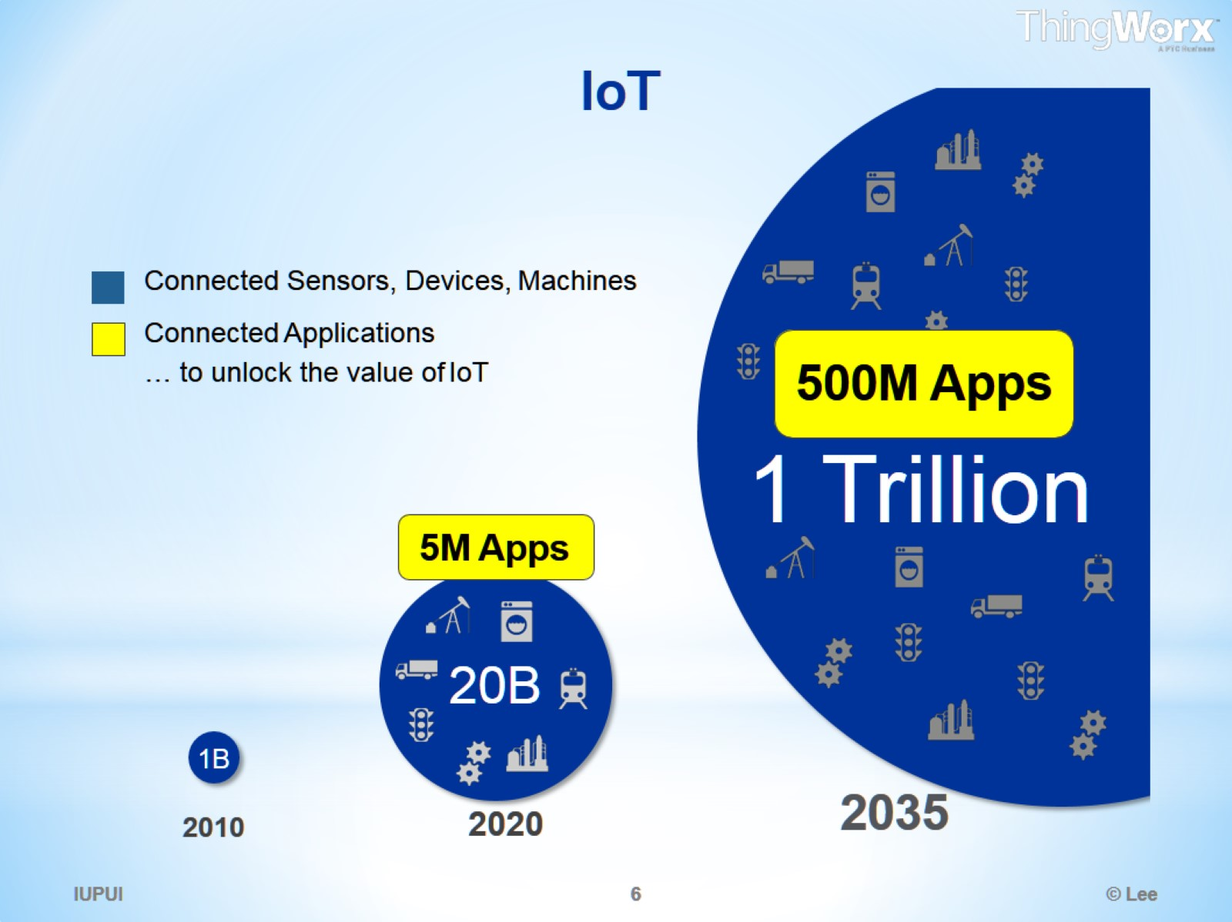
IoT

Slide 7
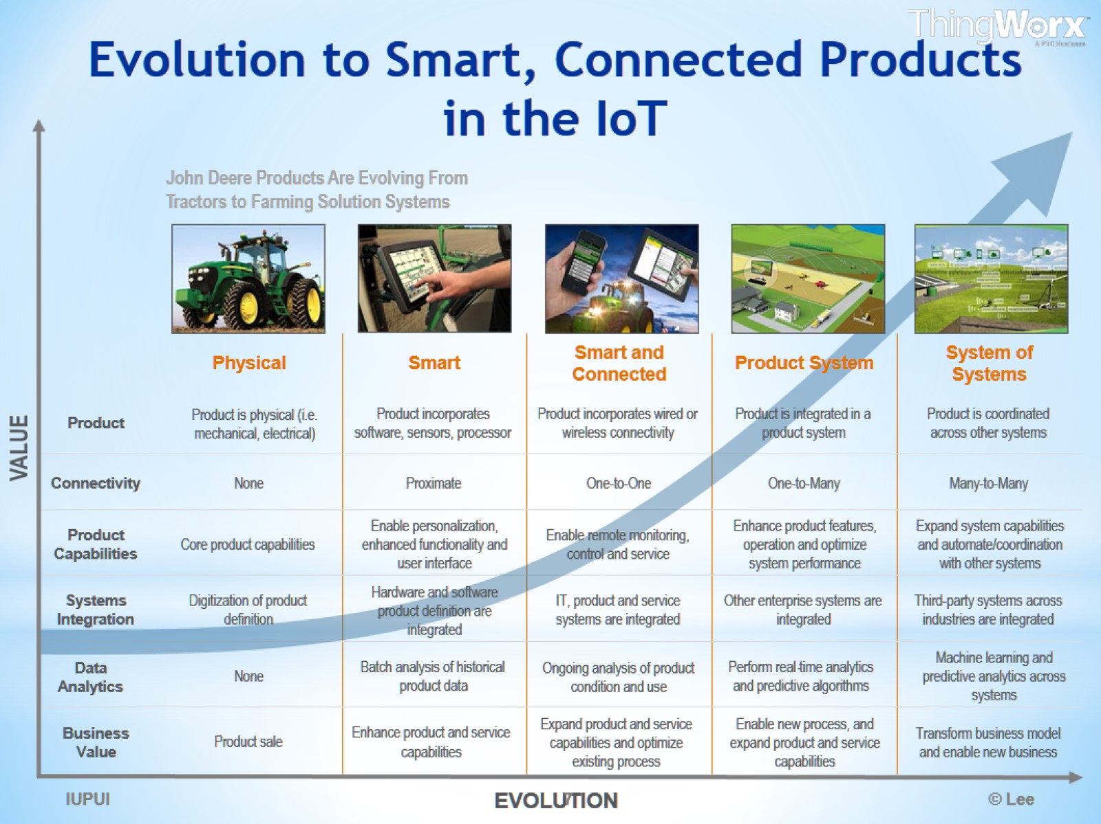
Evolution to Smart, Connected Products in the IoT

Slide 8
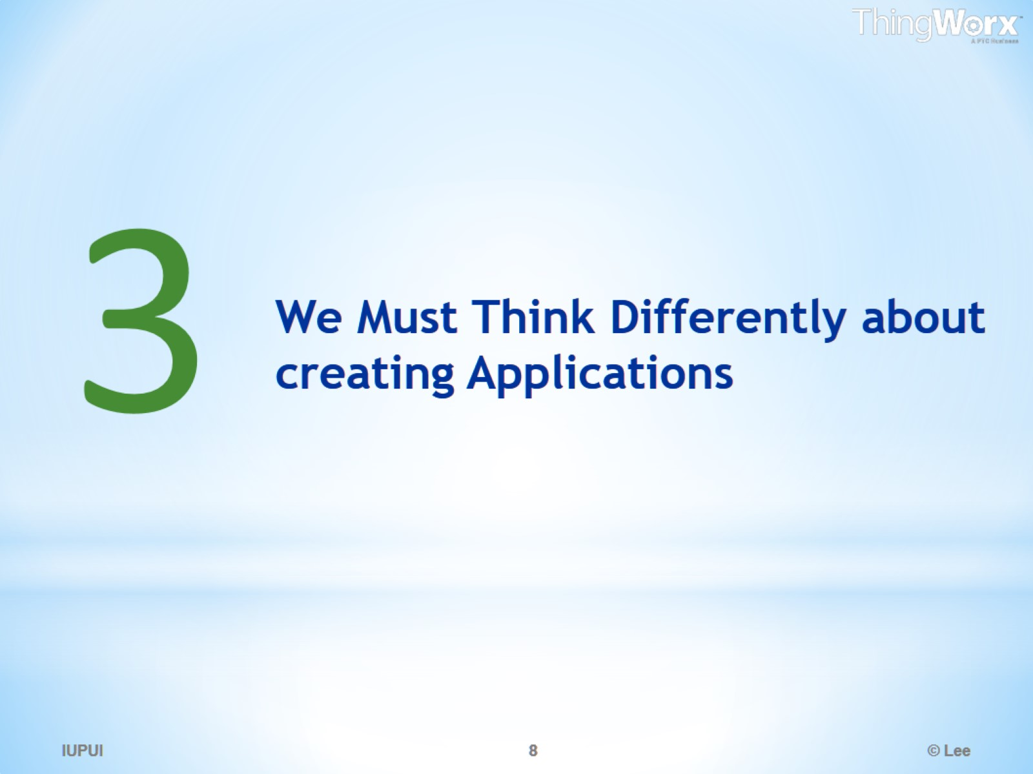
We Must Think Differently about creating Applications

Slide 9
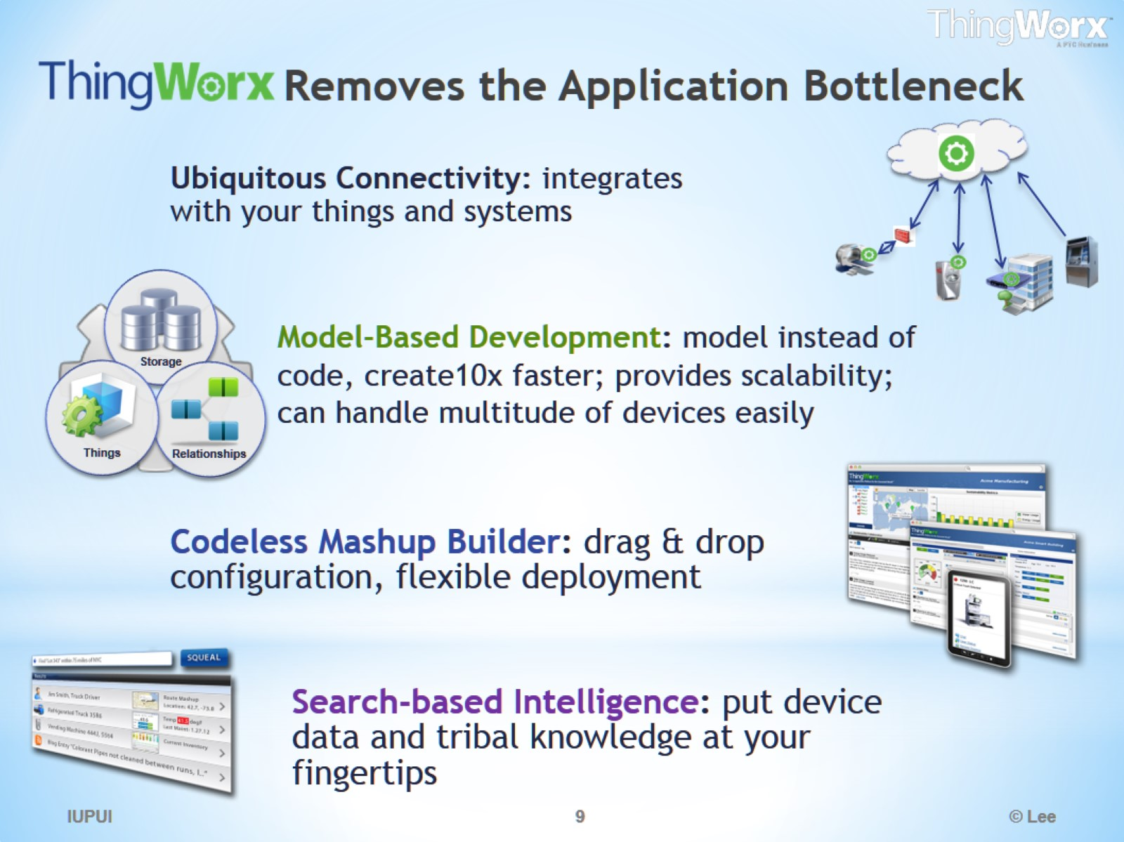
Removes the Application Bottleneck

Slide 10
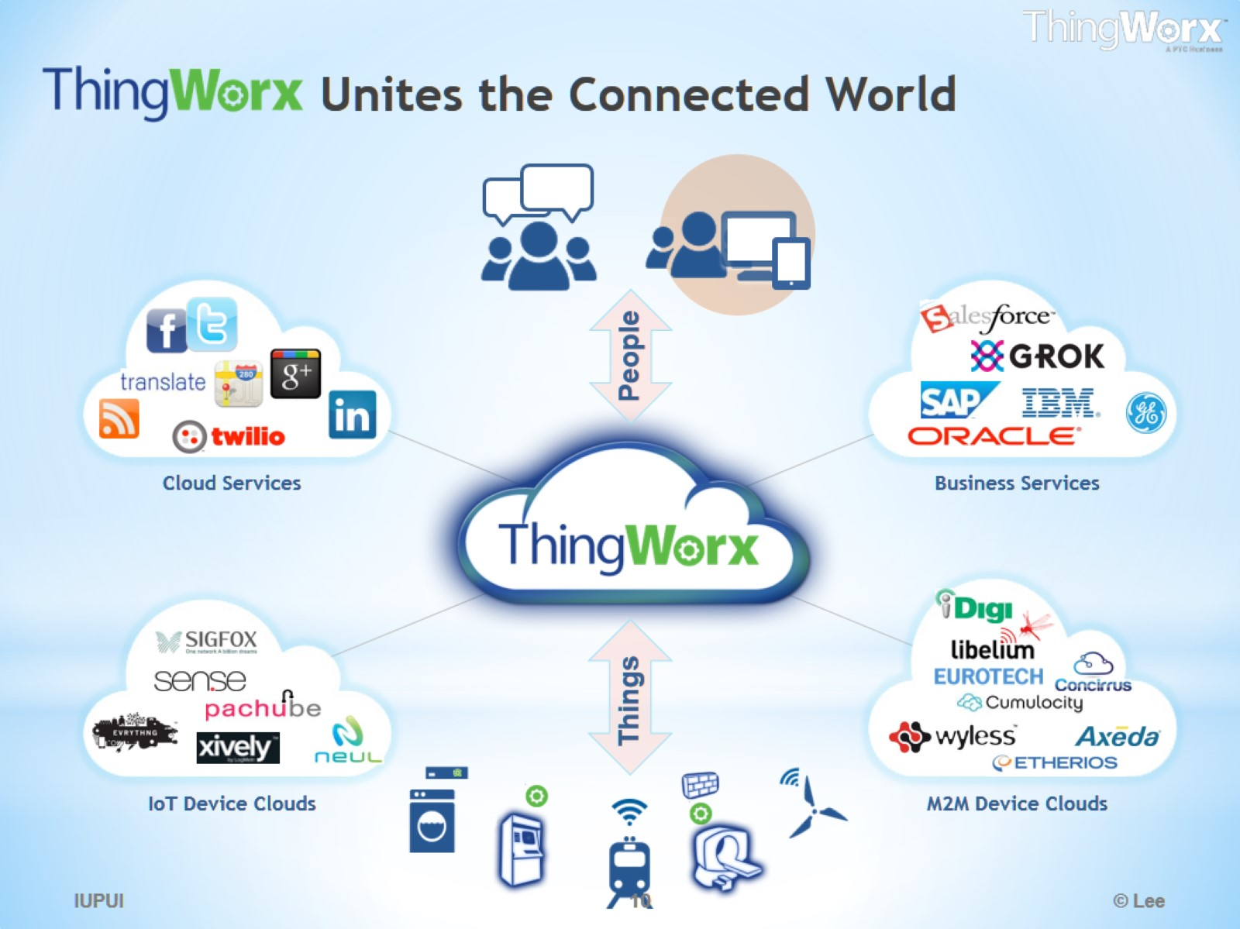
Unites the Connected World

Slide 11
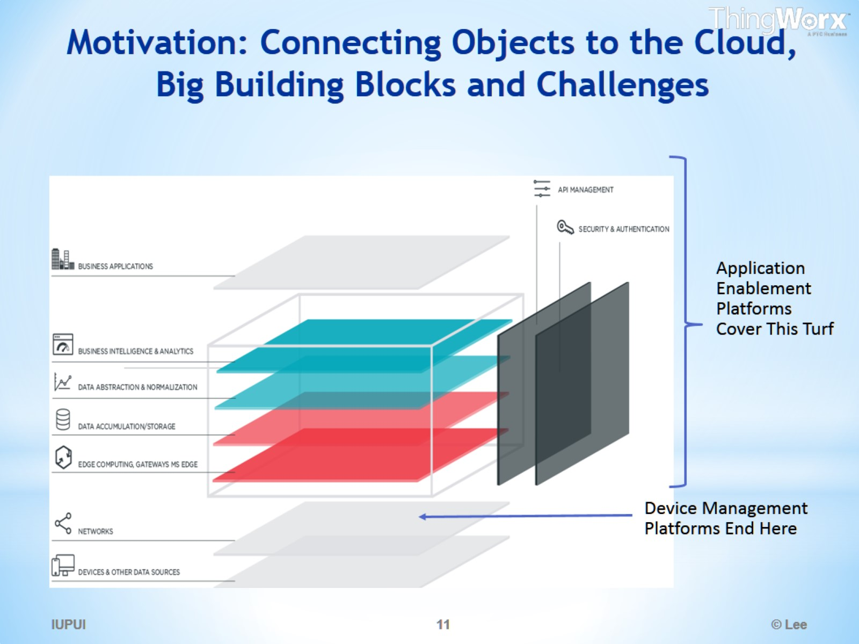
Motivation: Connecting Objects to the Cloud, Big Building Blocks and Challenges

Slide 12
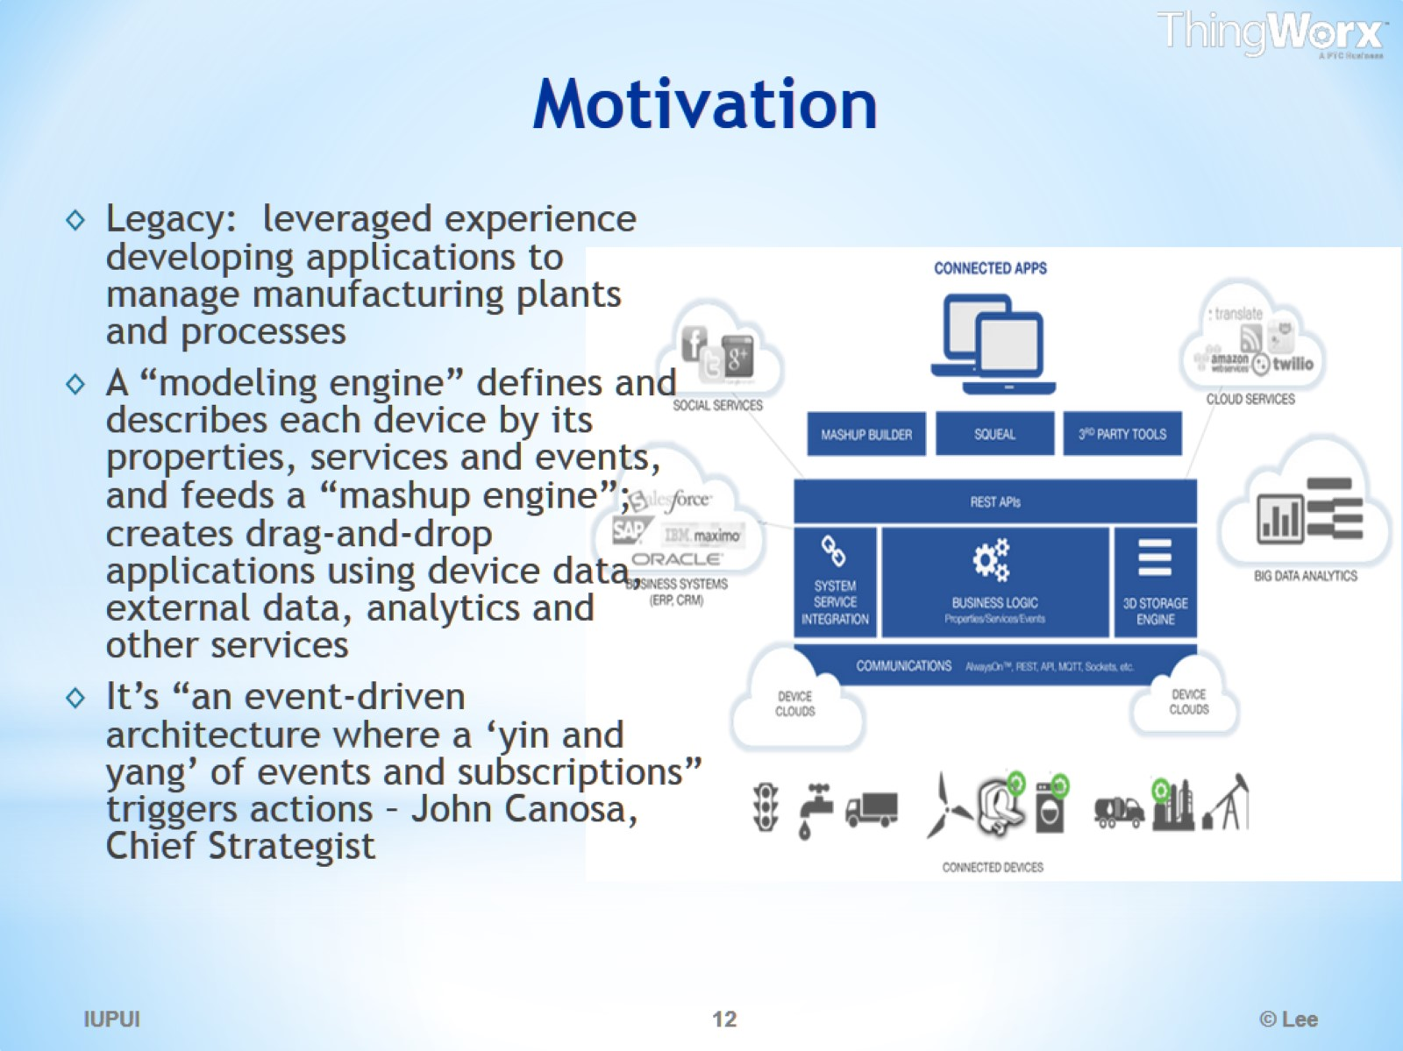
Motivation

Slide 13
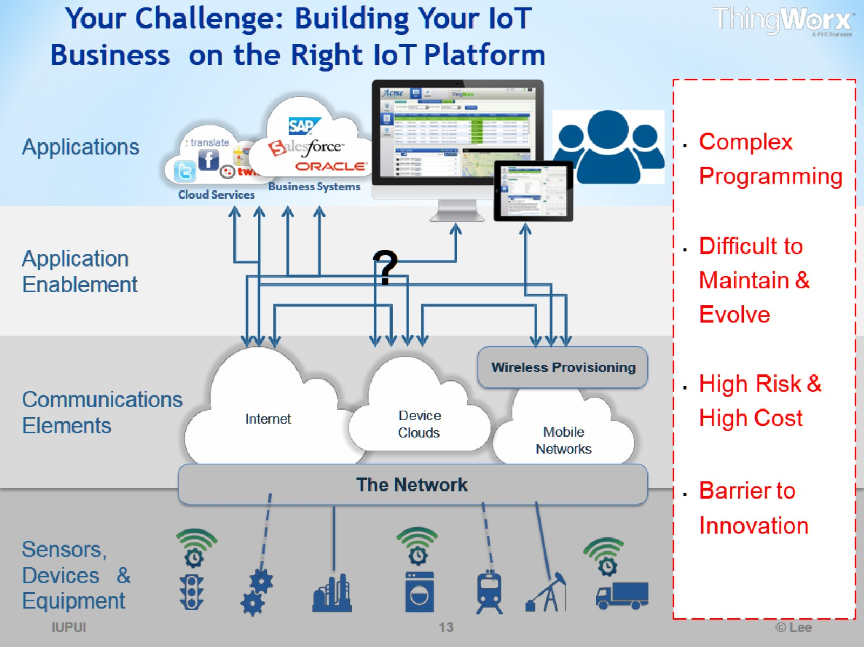
Your Challenge: Building Your IoT Business on the Right IoT Platform

Slide 14
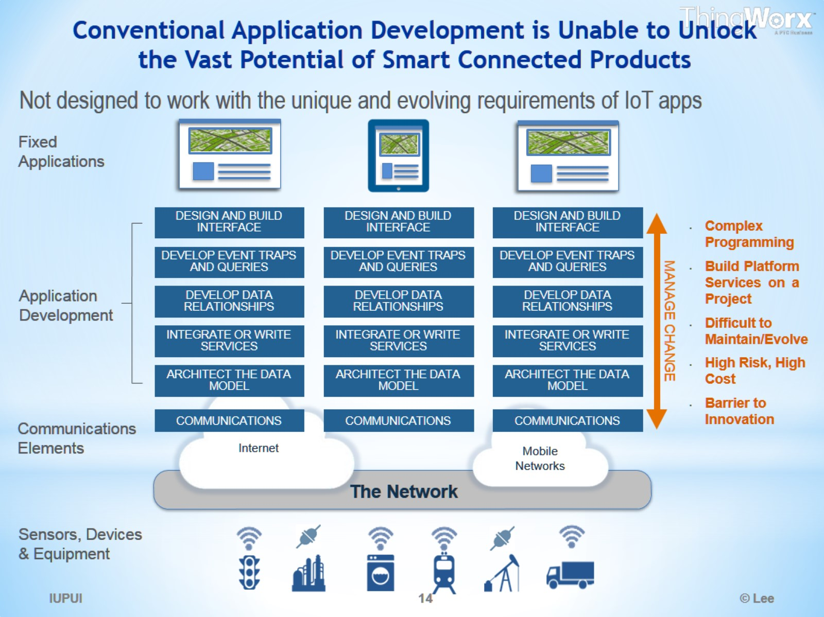
Conventional Application Development is Unable to Unlock the Vast Potential of Smart Connected Products

Slide 15
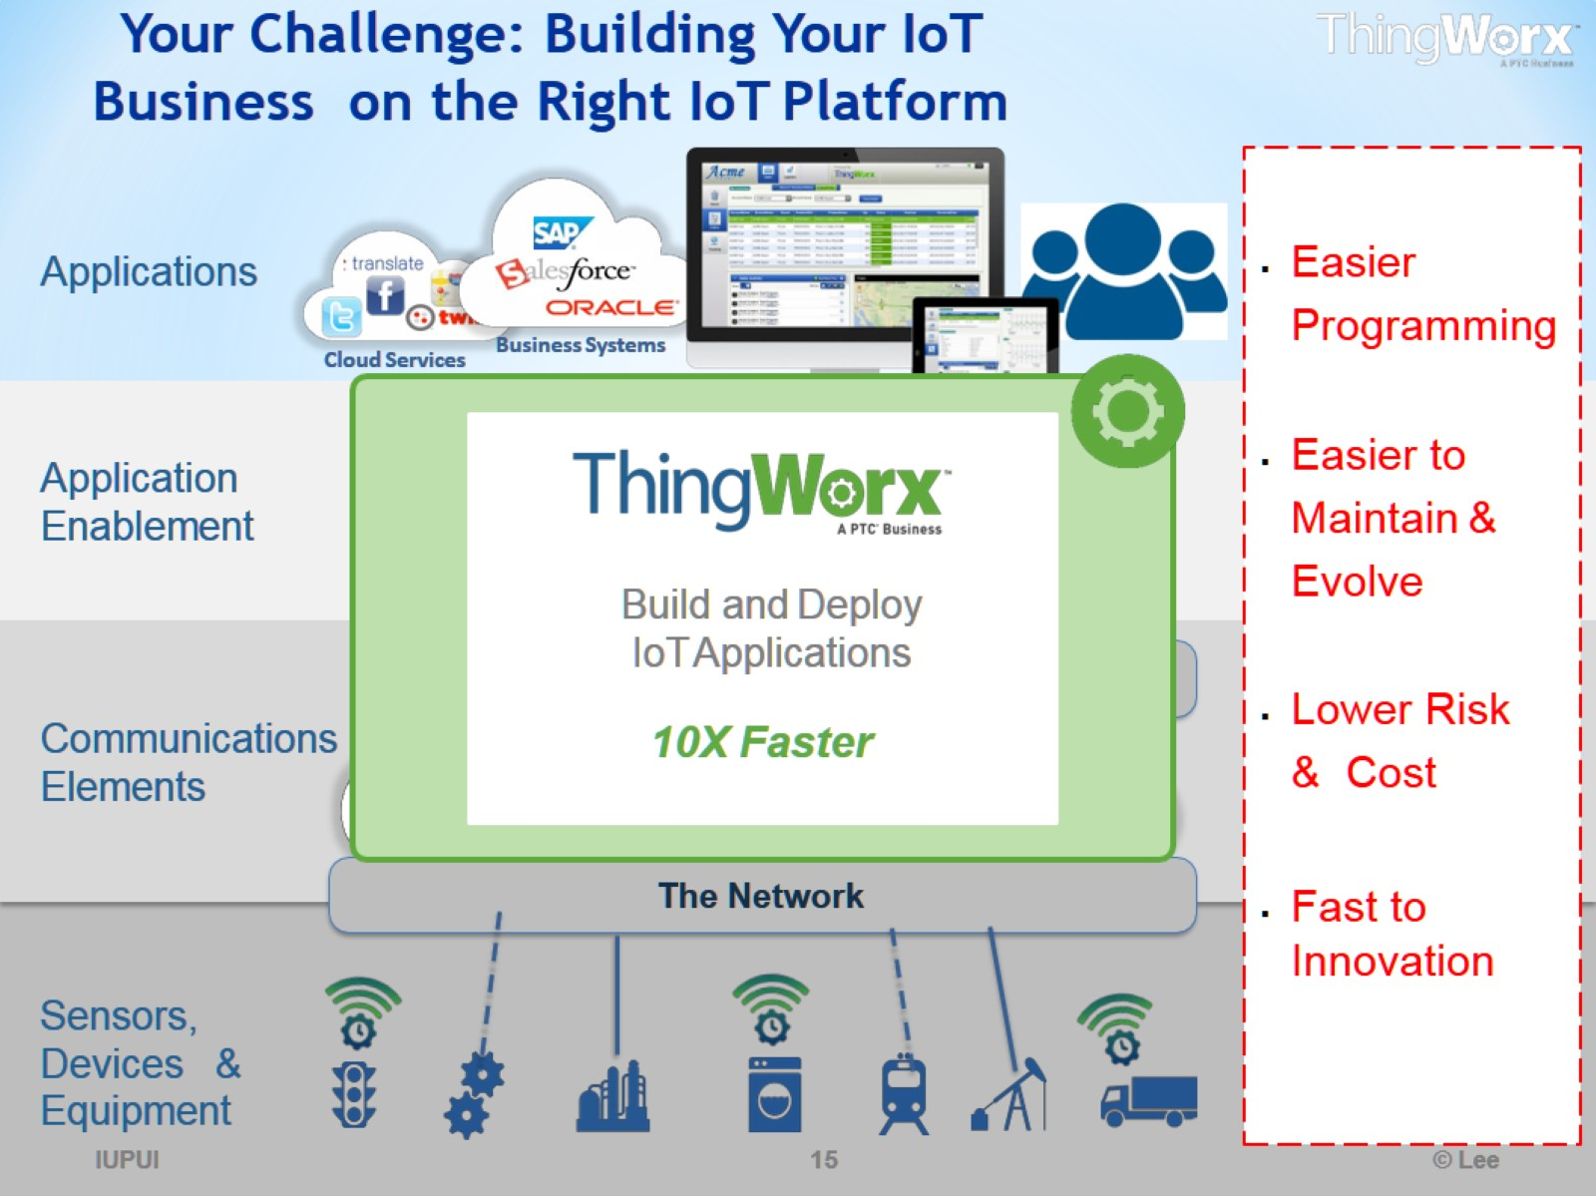
Your Challenge: Building Your IoT Business on the Right IoT Platform

Slide 16
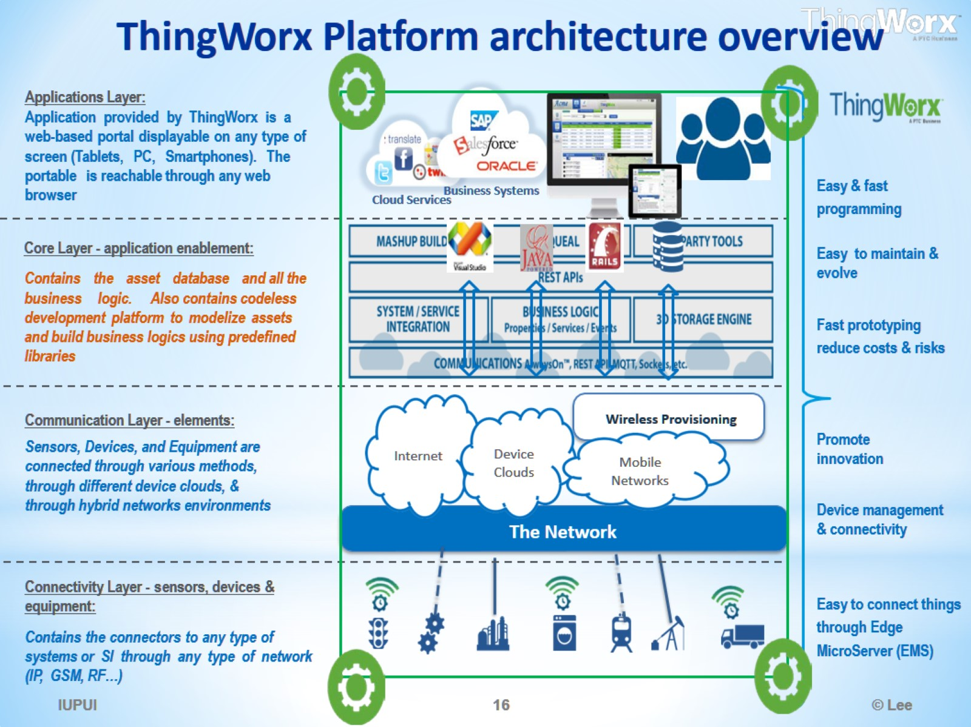
ThingWorx Platform architecture overview

Slide 17
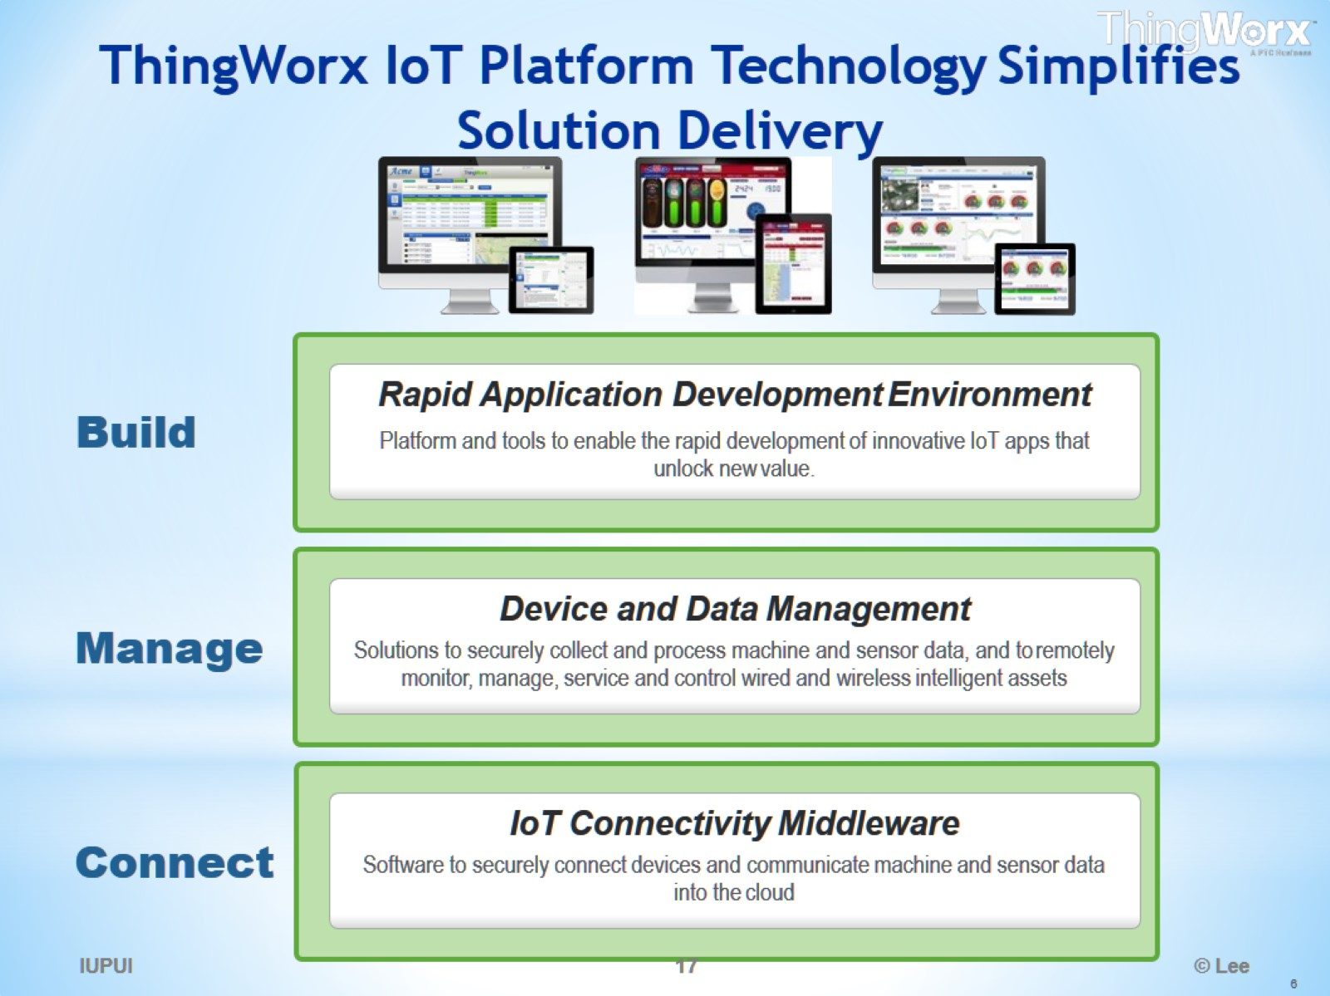
ThingWorx IoT Platform Technology Simplifies Solution Delivery

Slide 18
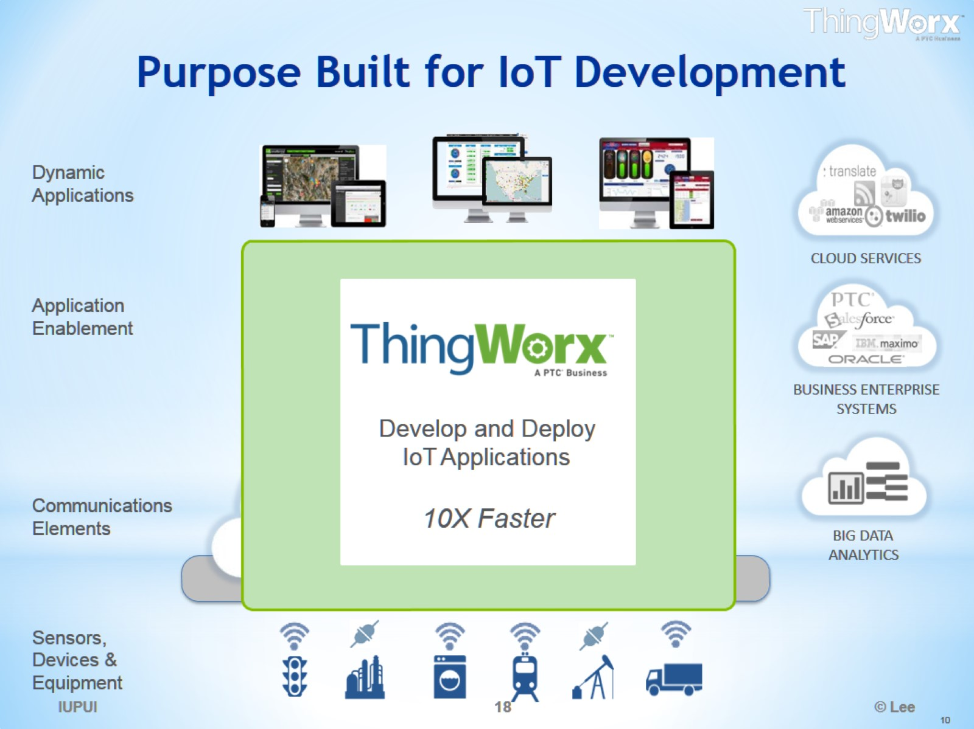
Purpose Built for IoT Development

Slide 19
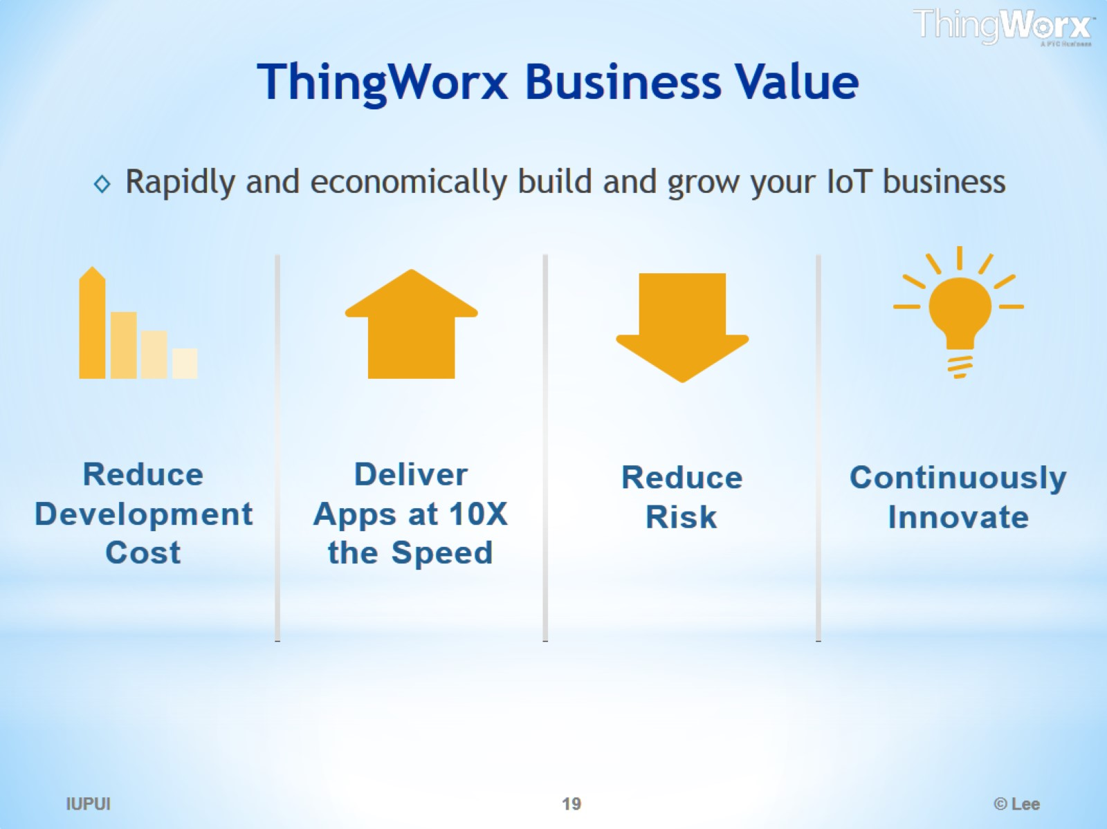
ThingWorx Business Value

Slide 20
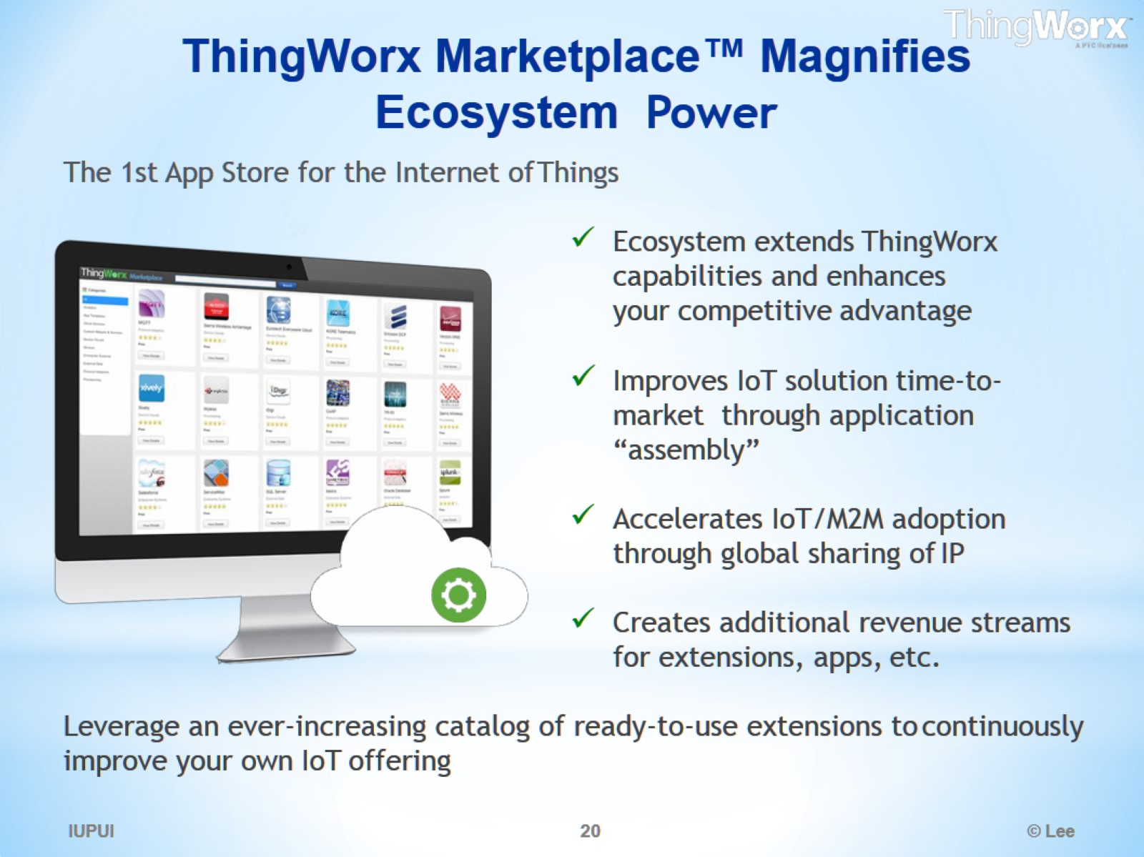
ThingWorx Marketplace™ Magnifies Ecosystem Power

Slide 21
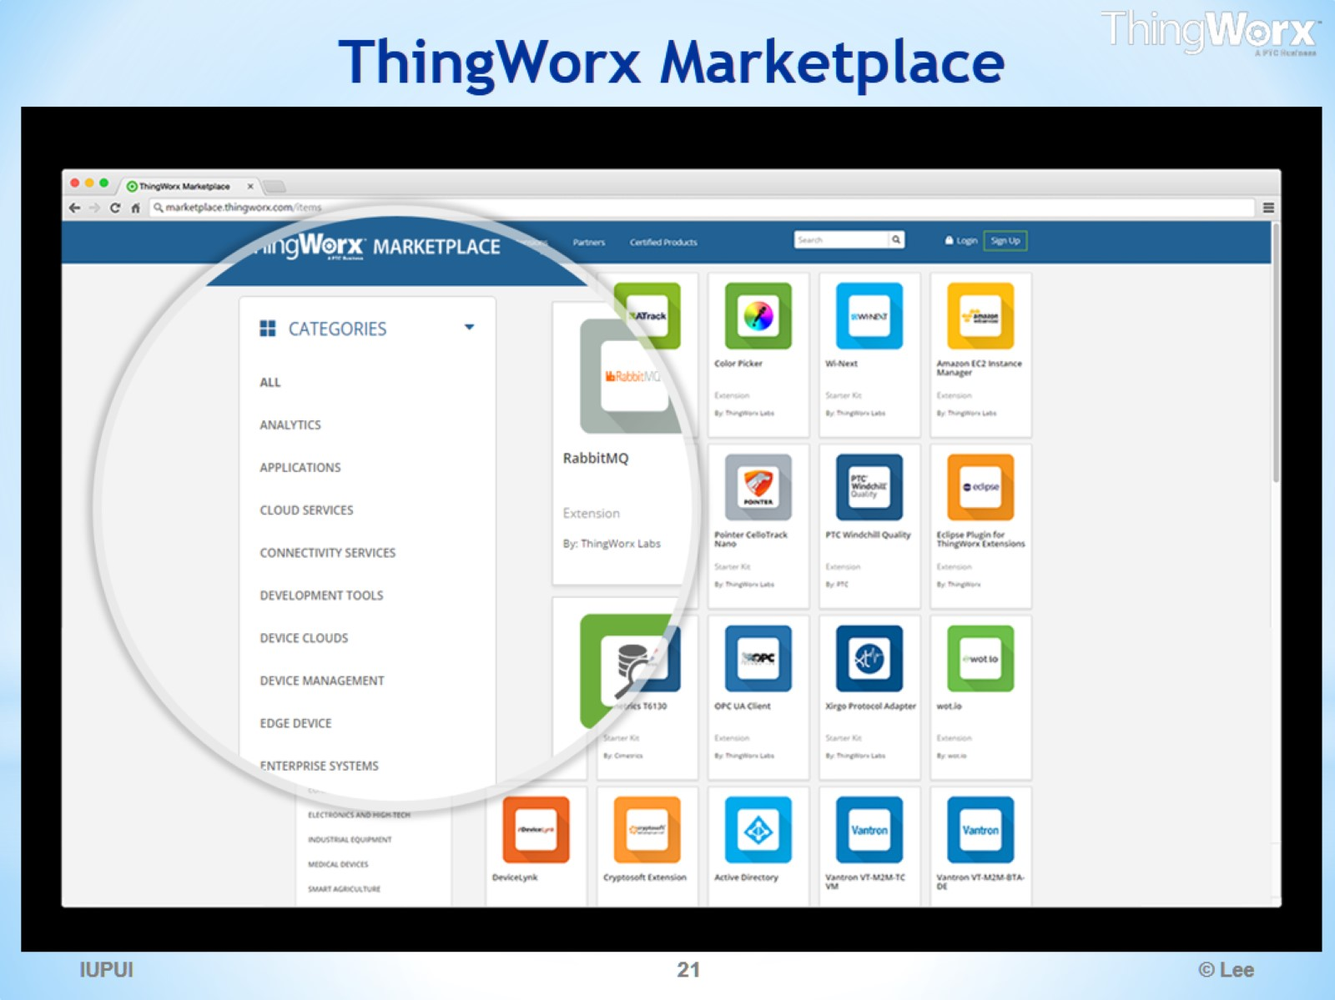
ThingWorx Marketplace

Slide 22
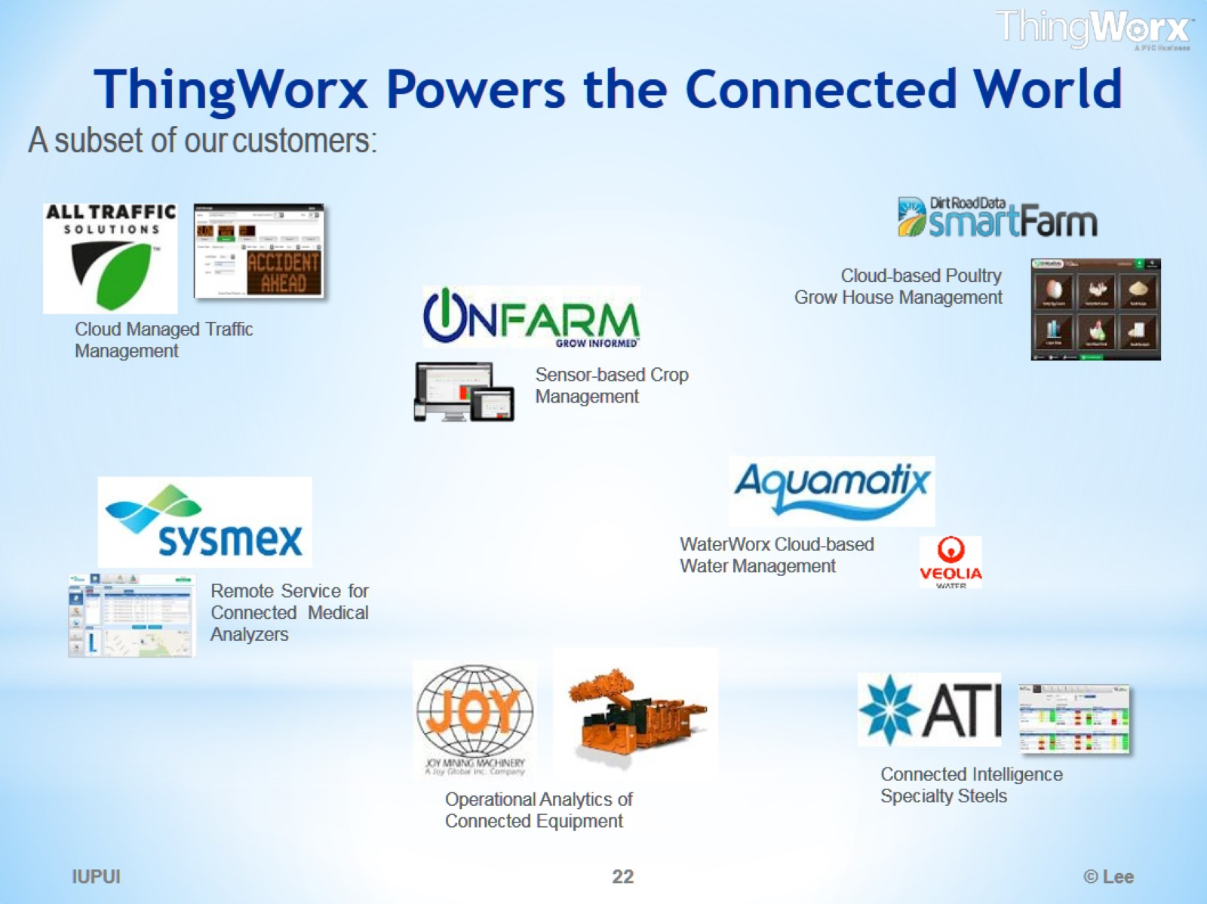
ThingWorx Powers the Connected World

Slide 23
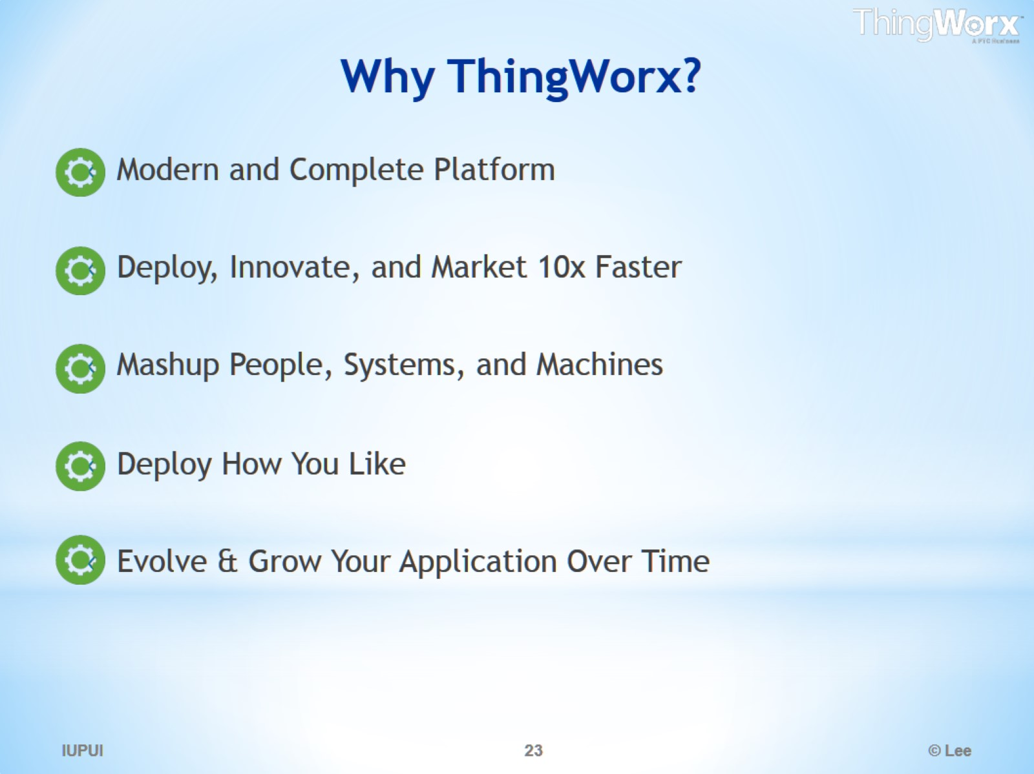
Why ThingWorx?

Slide 24
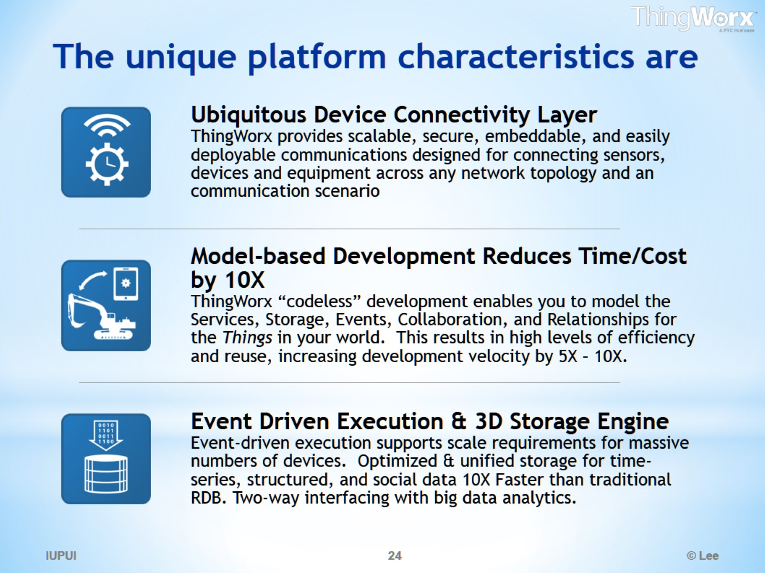
The unique platform characteristics are

Slide 25
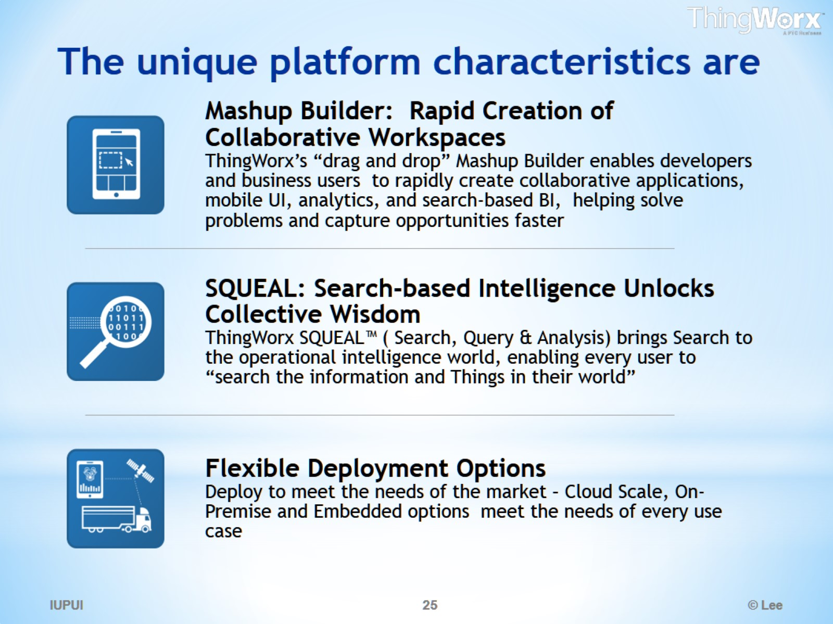
The unique platform characteristics are

Slide 26
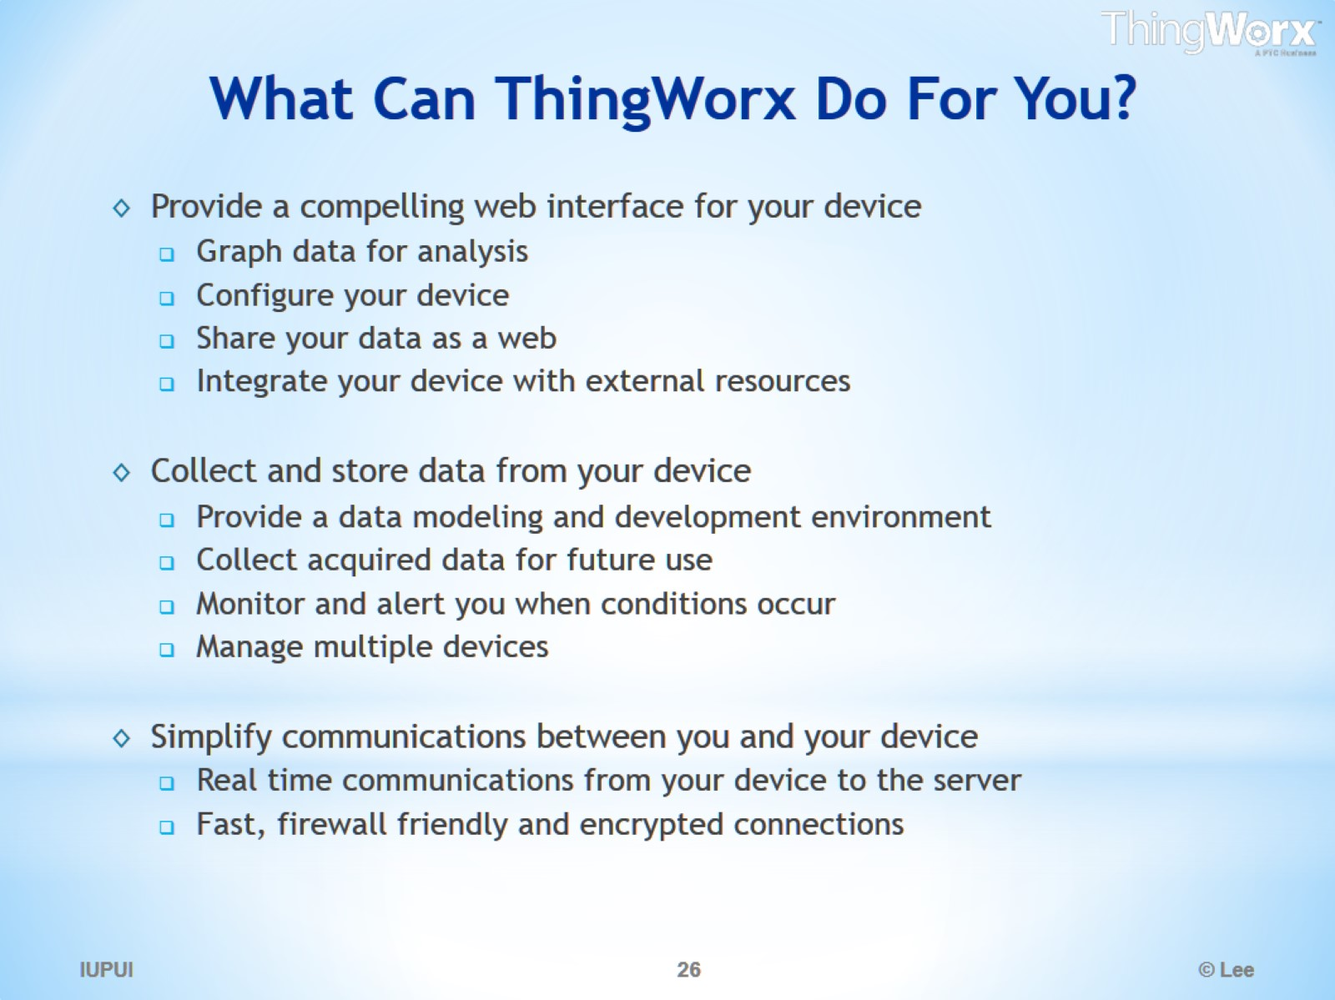
What Can ThingWorx Do For You?

Slide 27
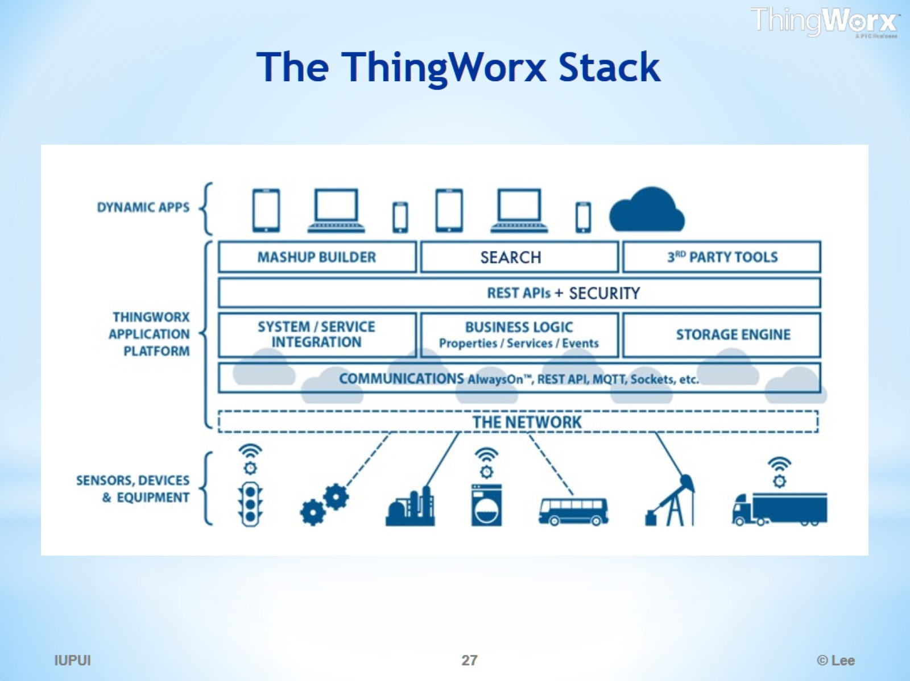
The ThingWorx Stack

Slide 28
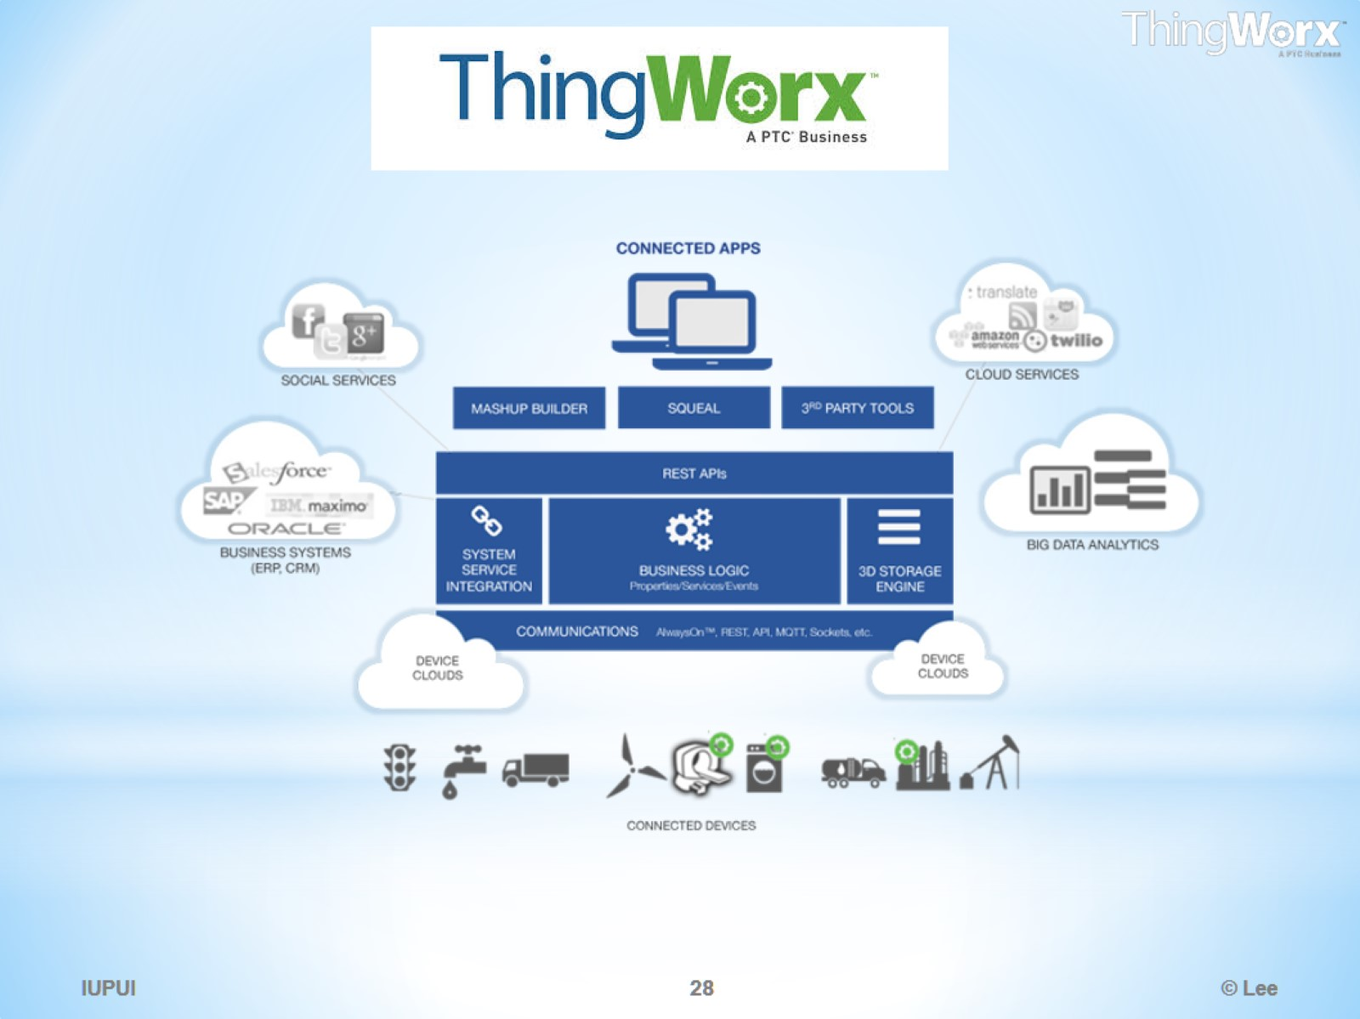

Slide 29
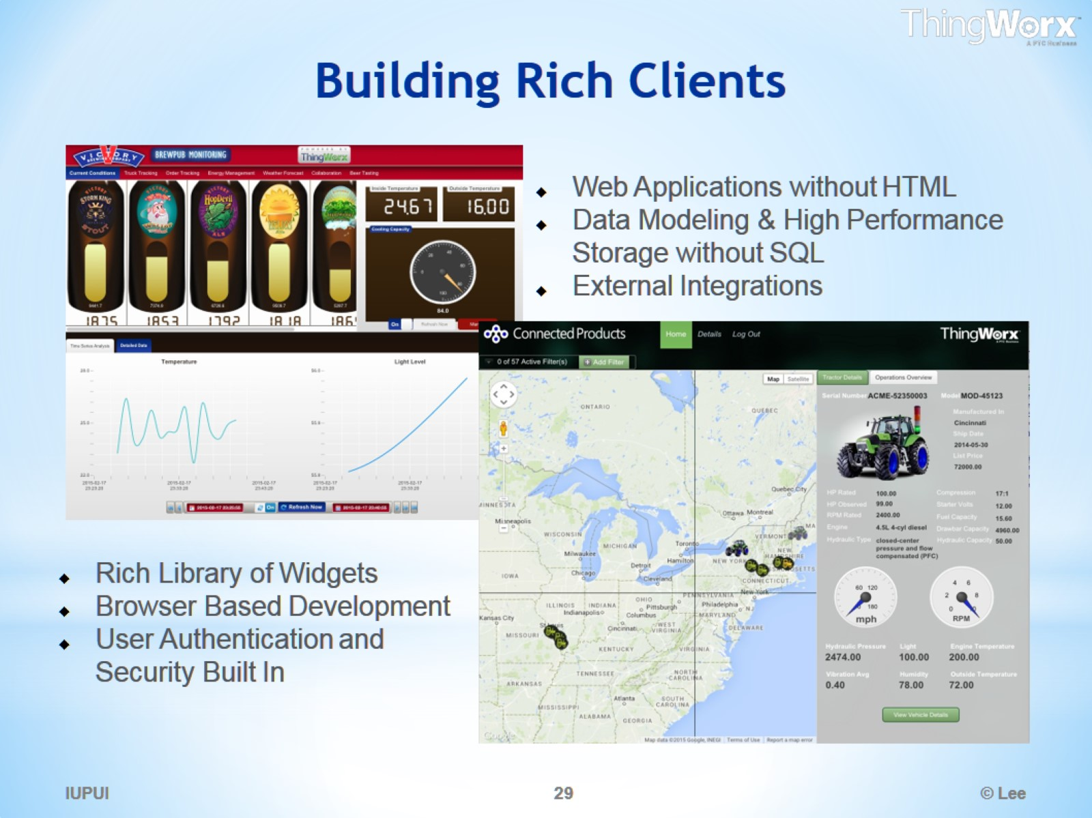
Building Rich Clients

Slide 30
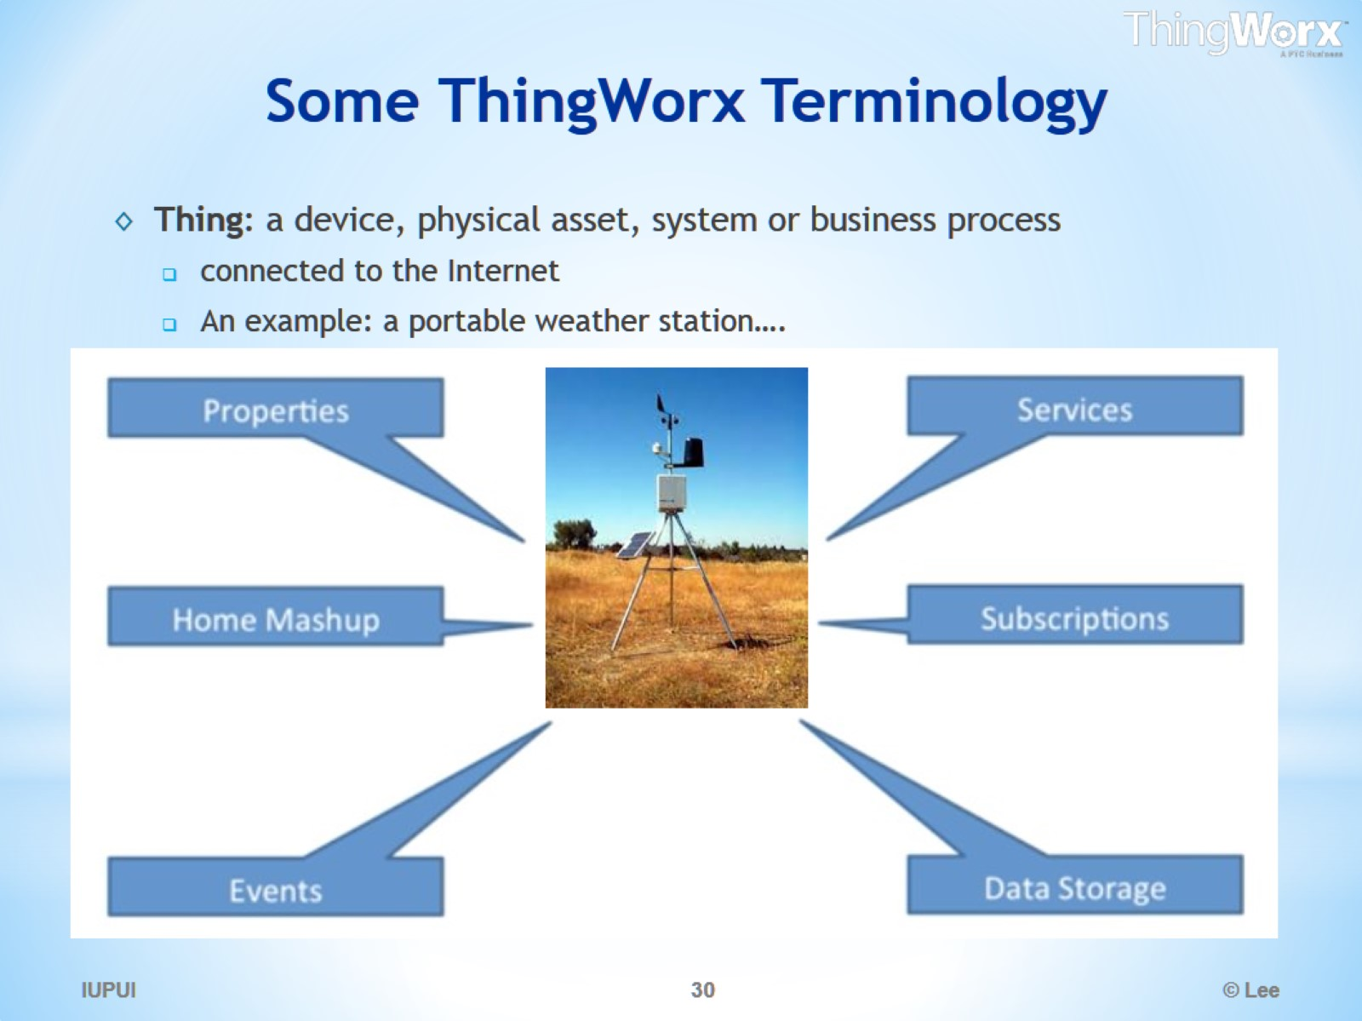
Some ThingWorx Terminology

Slide 31
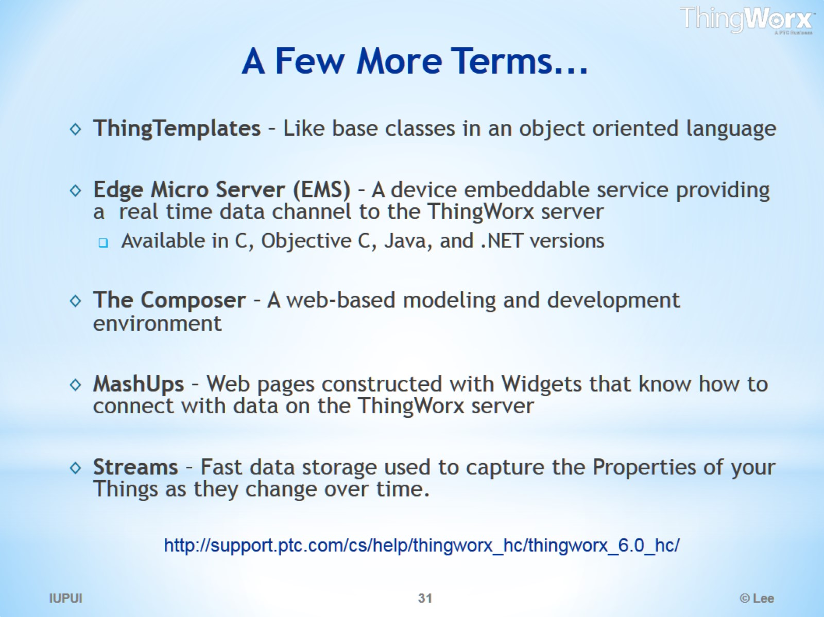
A Few More Terms…

Slide 32
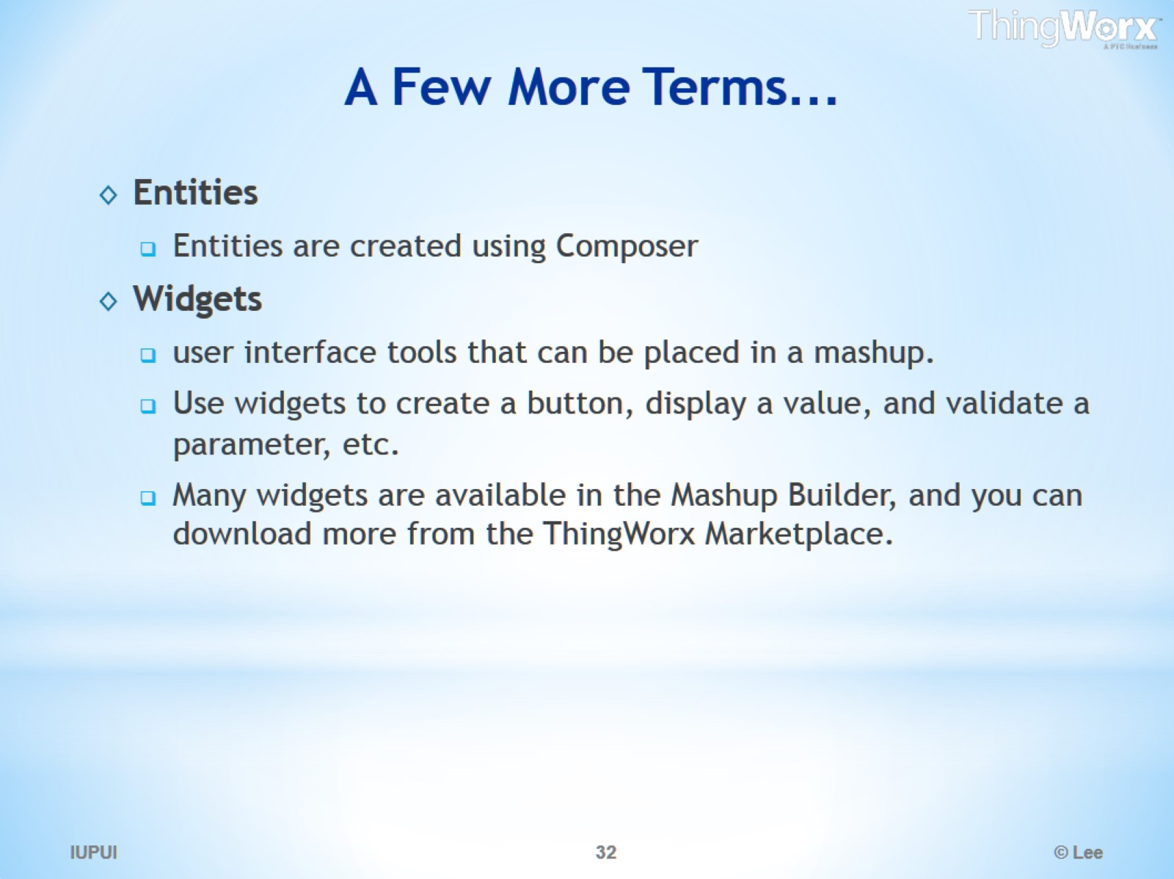
A Few More Terms…

Slide 33
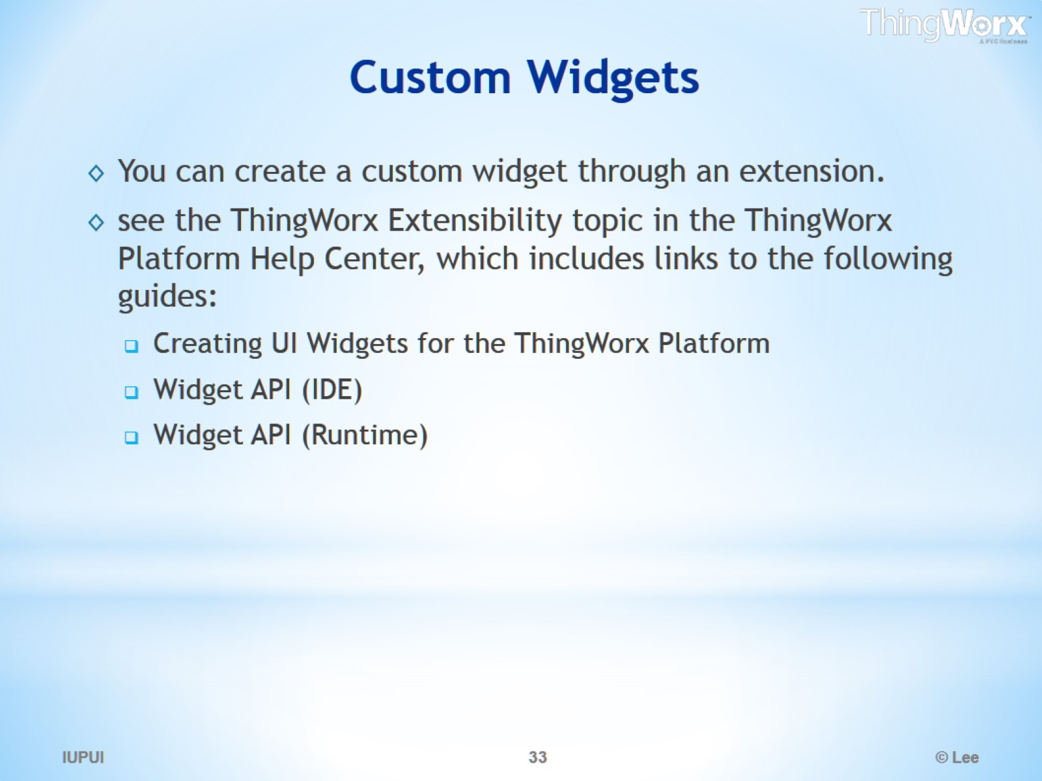
Custom Widgets

Slide 34
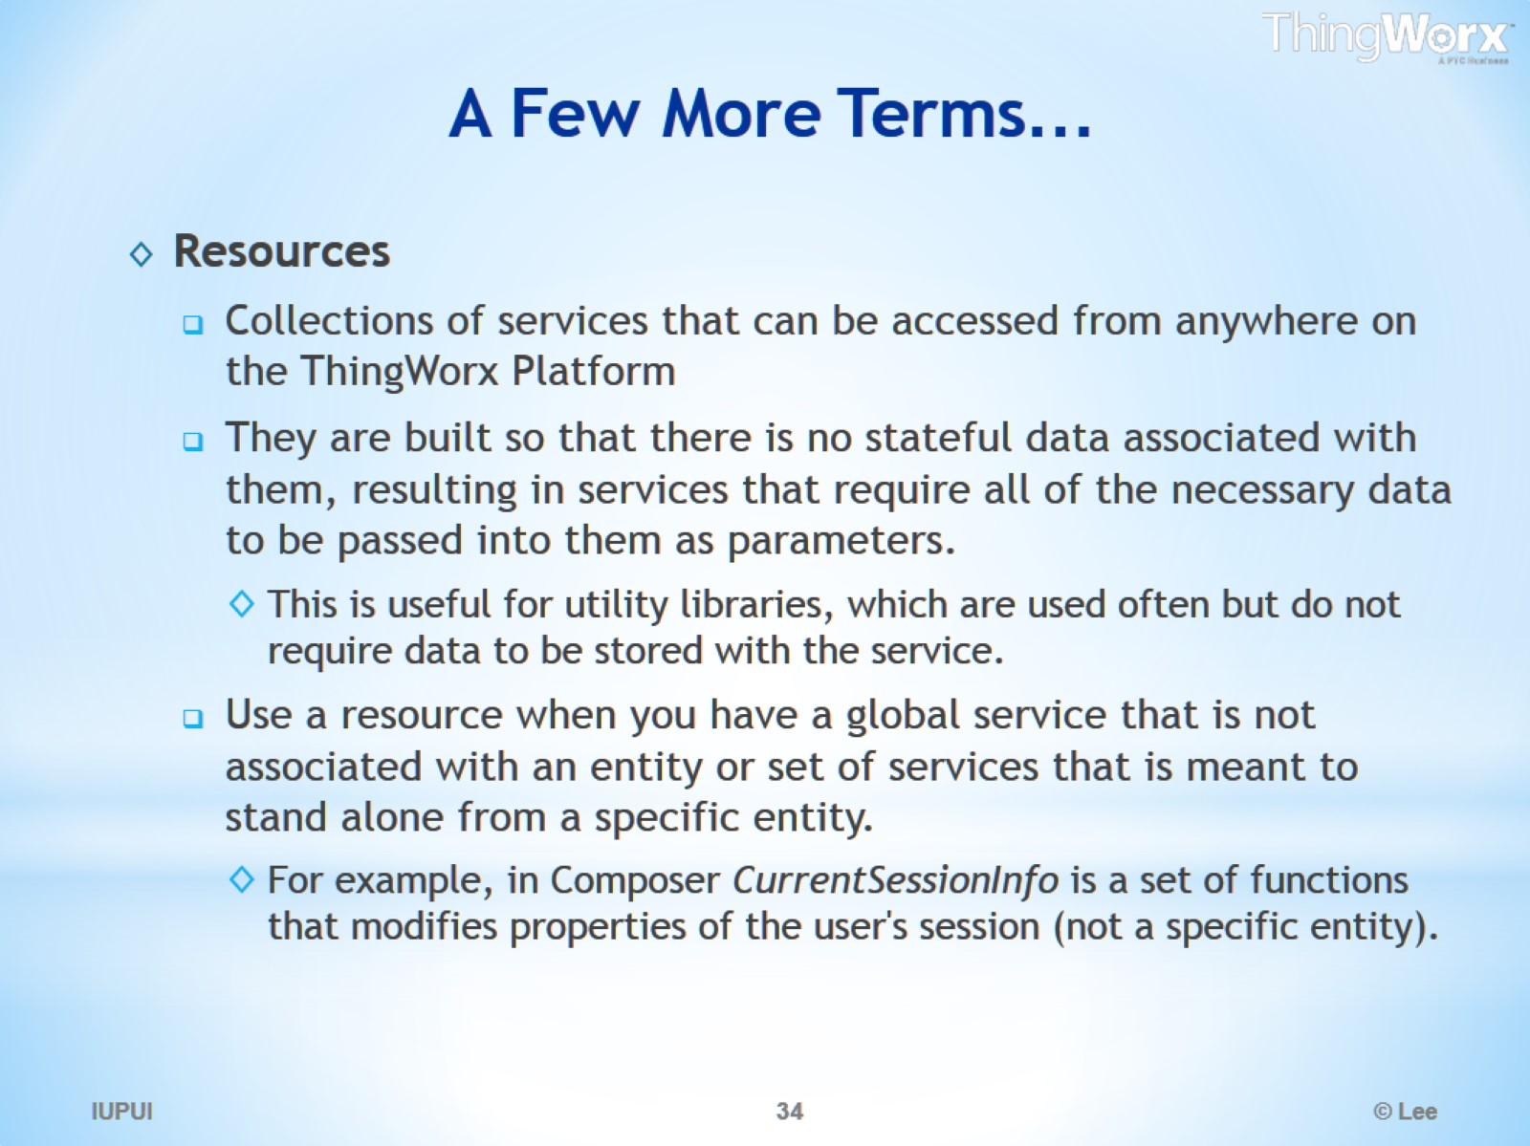
A Few More Terms…

Slide 35
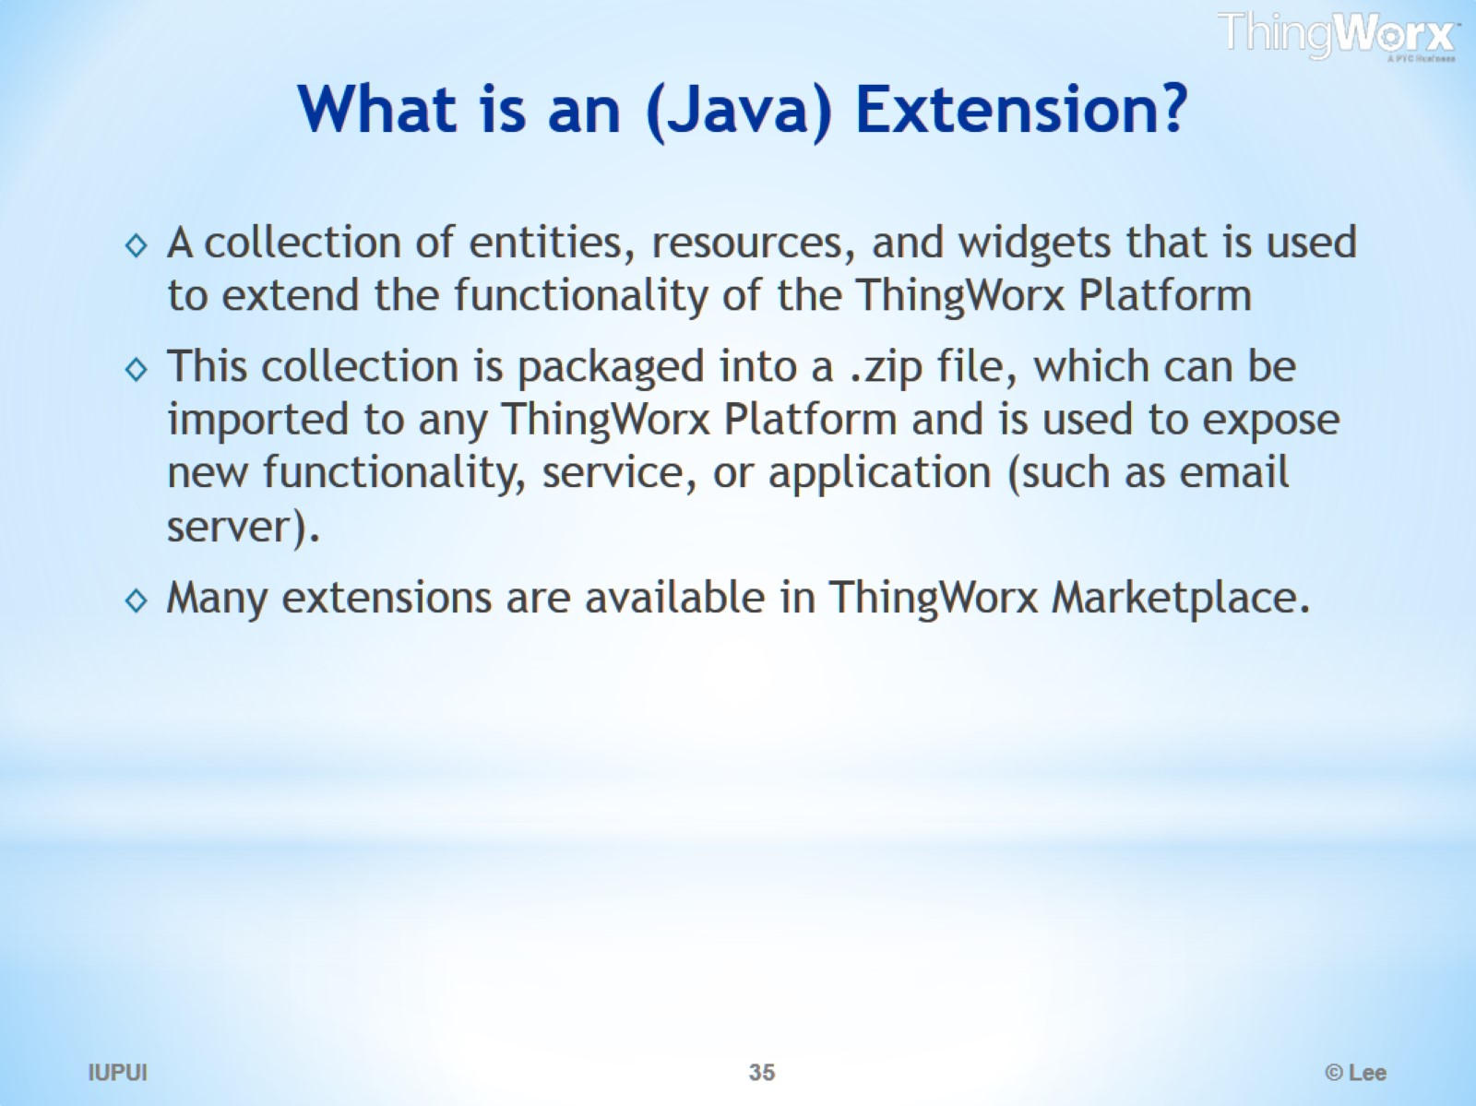
What is an (Java) Extension?

Slide 36
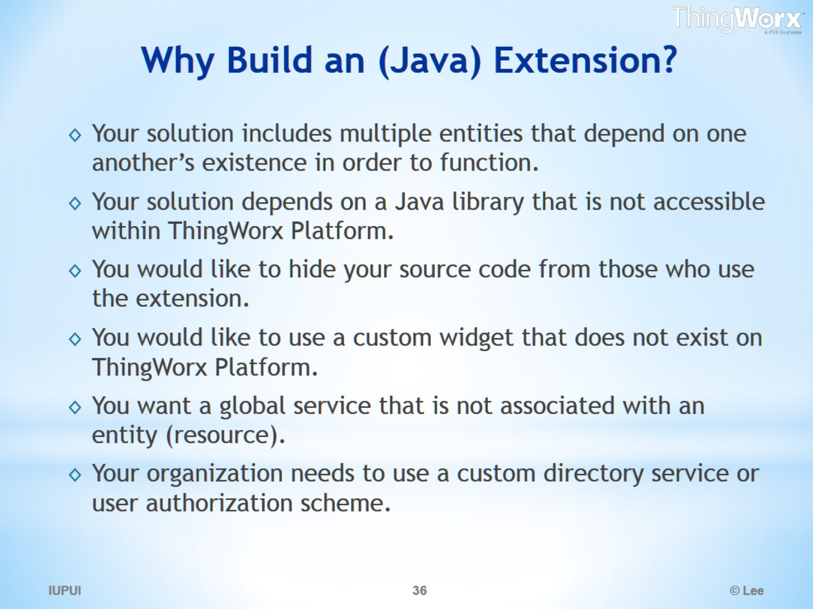
Why Build an (Java) Extension?

Slide 37
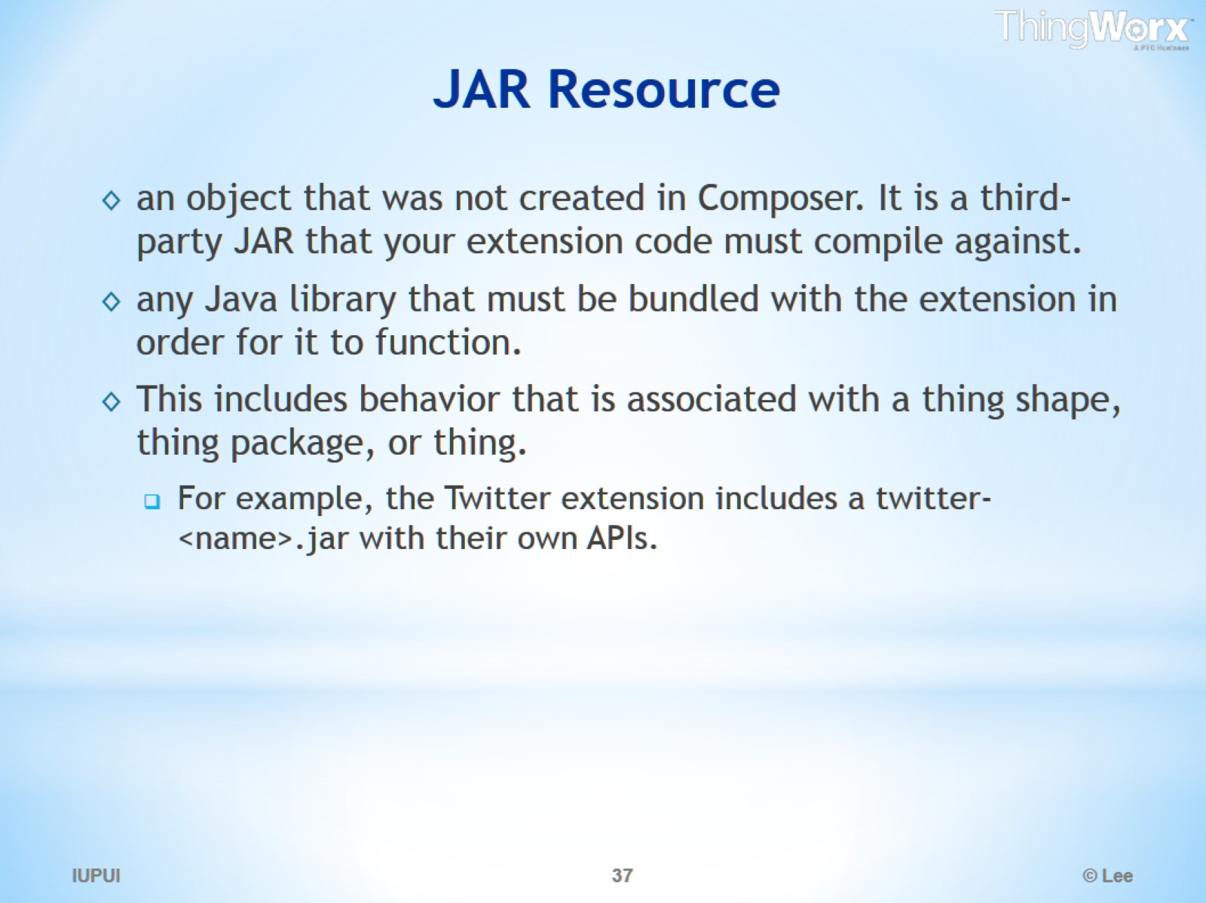
JAR Resource

Slide 38
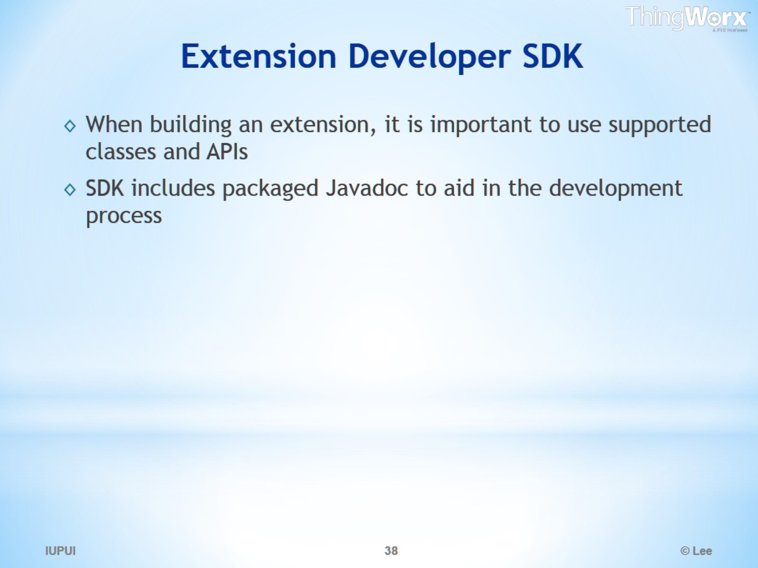
Extension Developer SDK

Slide 39
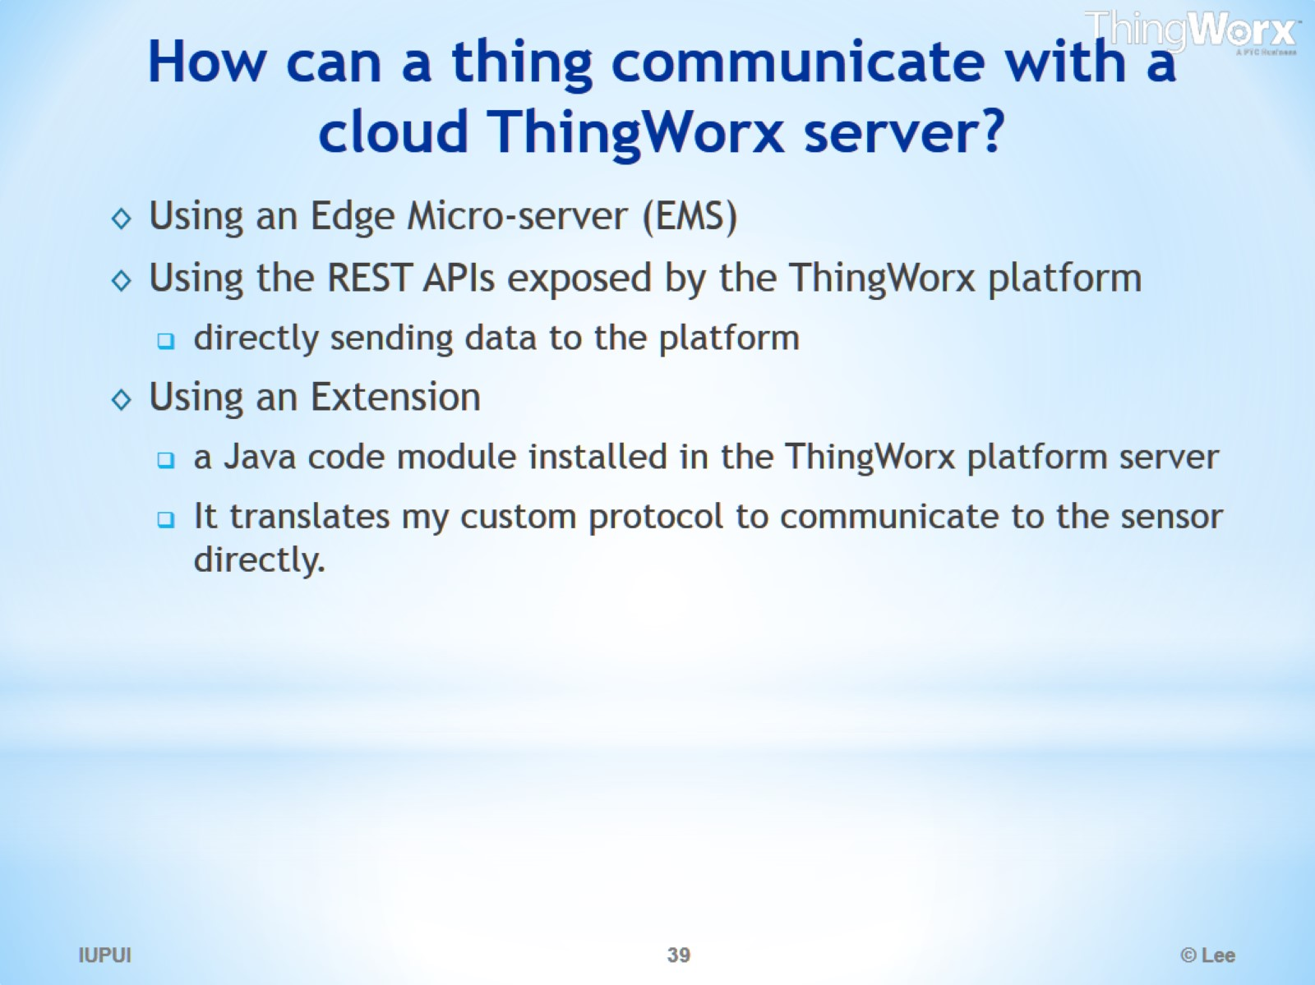
How can a thing communicate with a cloud ThingWorx server?

Slide 40
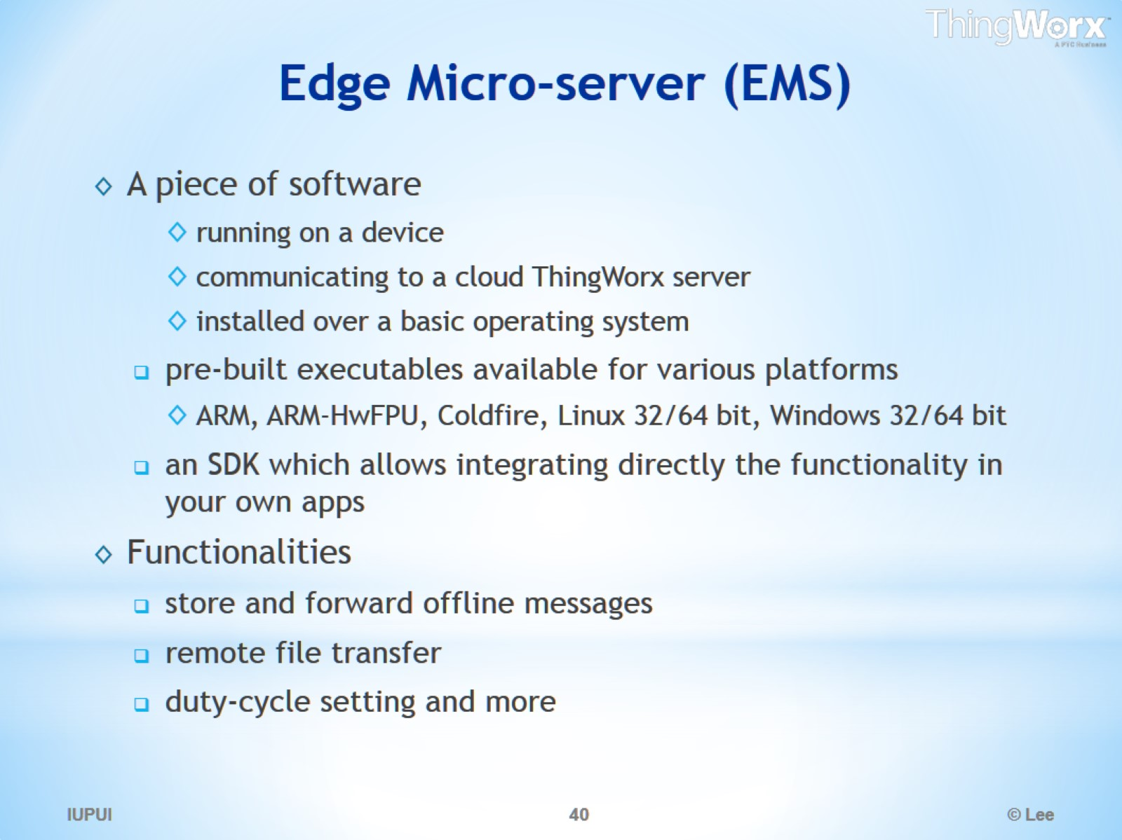
Edge Micro-server (EMS)

Slide 41
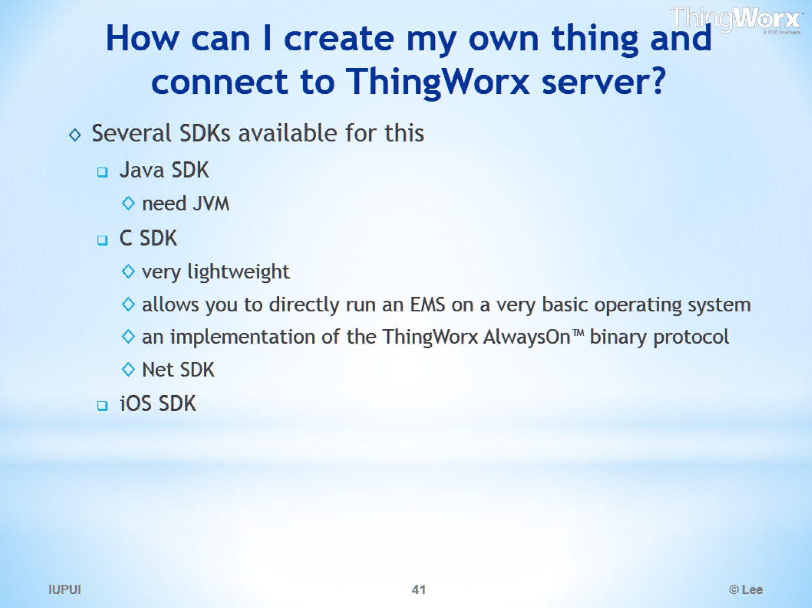
How can I create my own thing and connect to ThingWorx server?

Slide 42
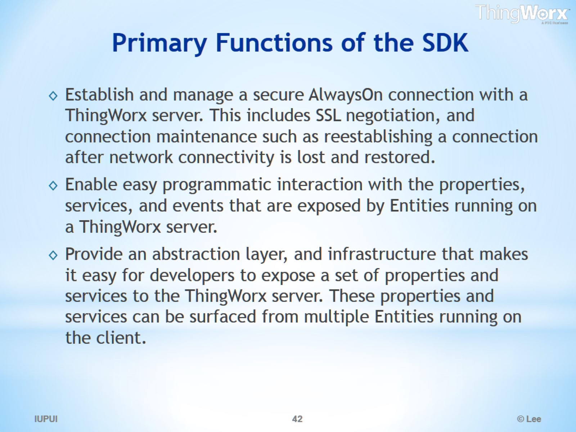
Primary Functions of the SDK

Slide 43
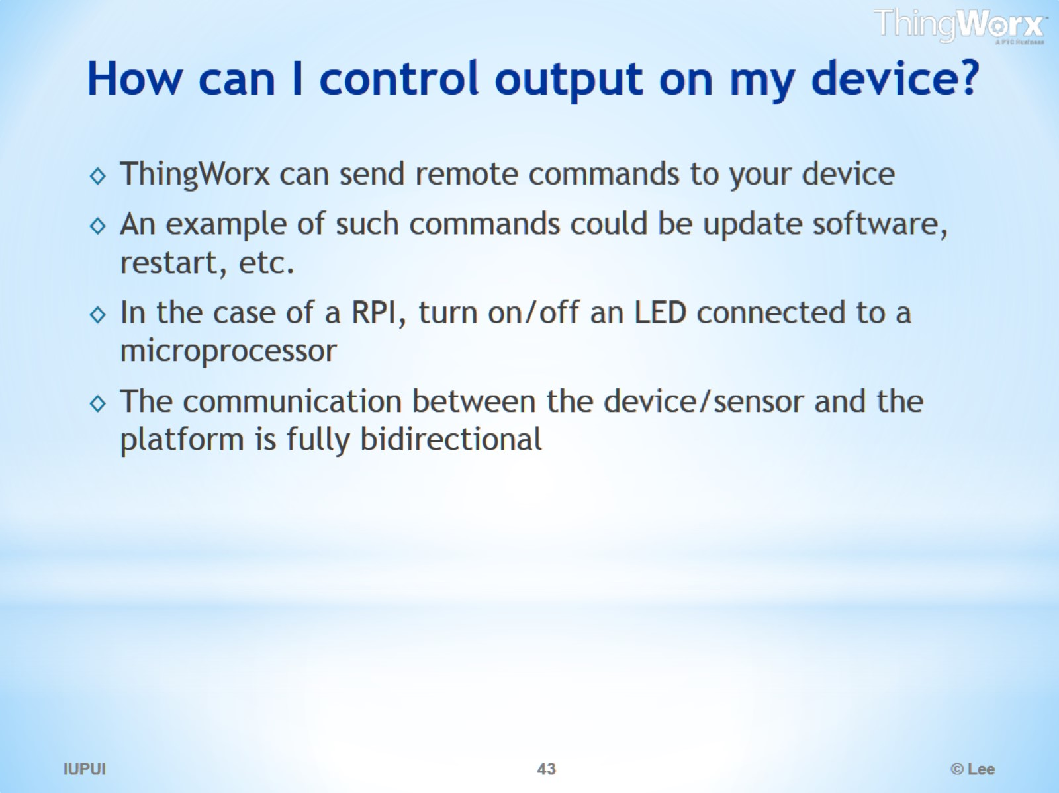
How can I control output on my device?

Slide 44
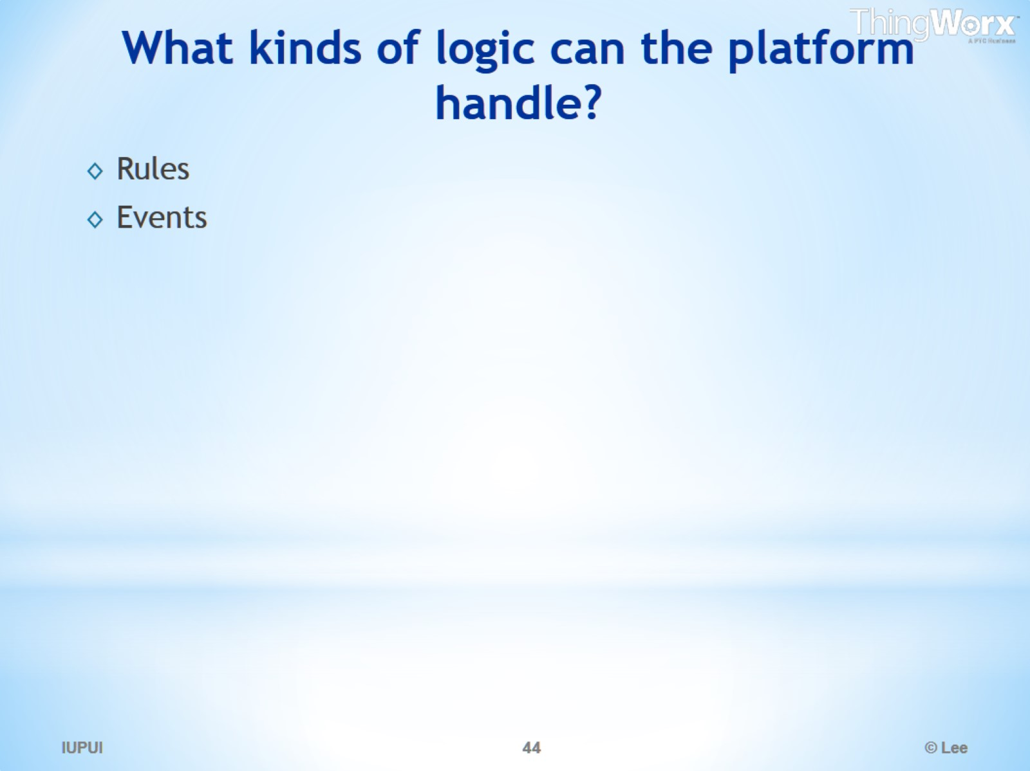
What kinds of logic can the platform handle?

Slide 45
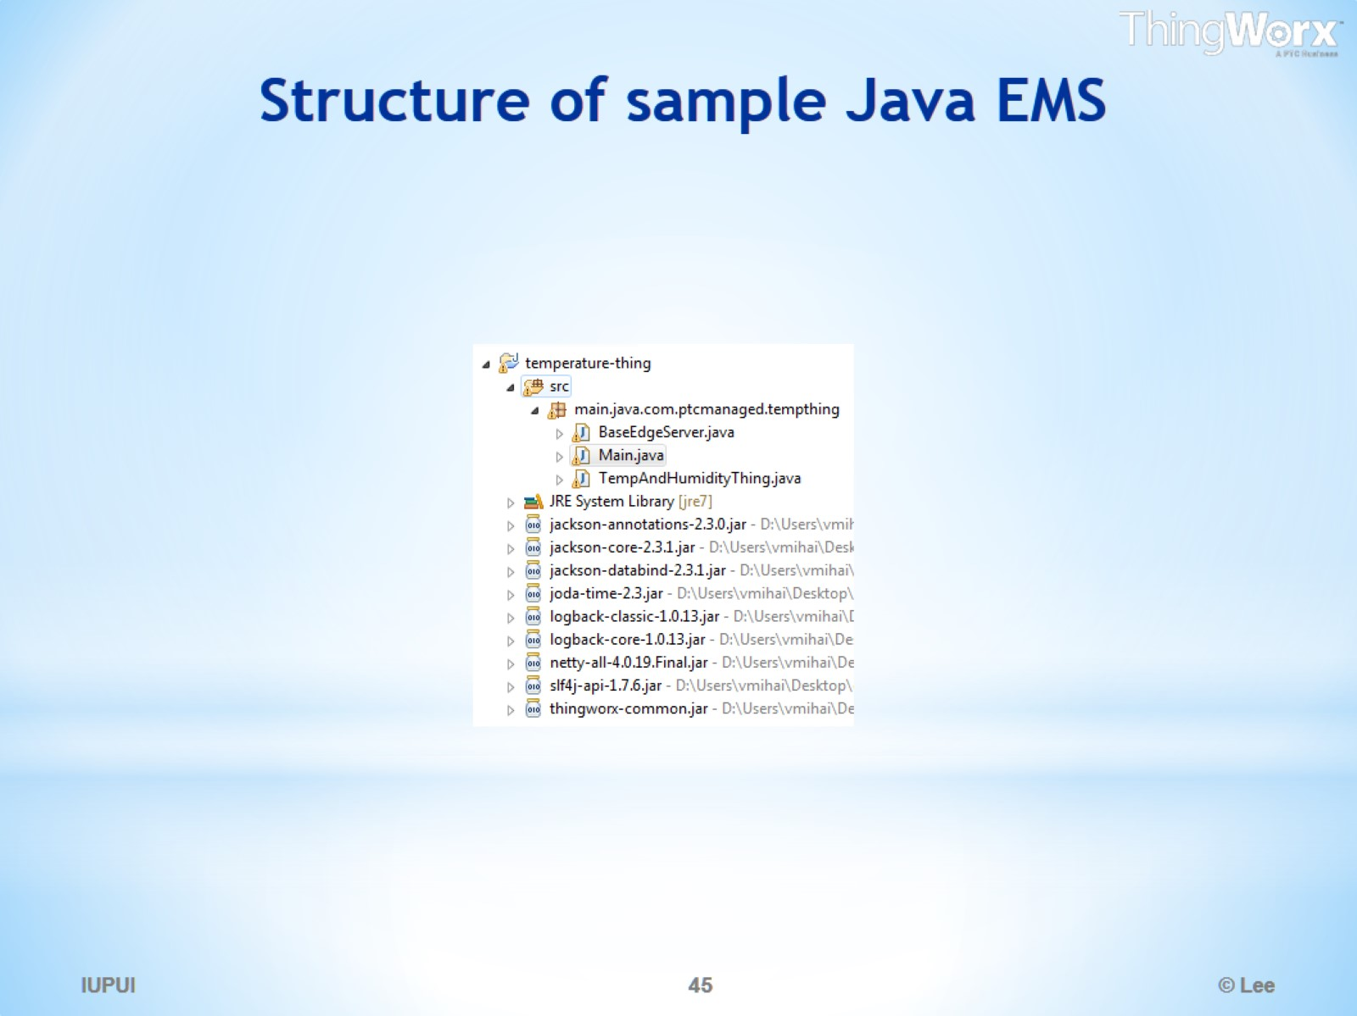
Structure of sample Java EMS

Slide 46
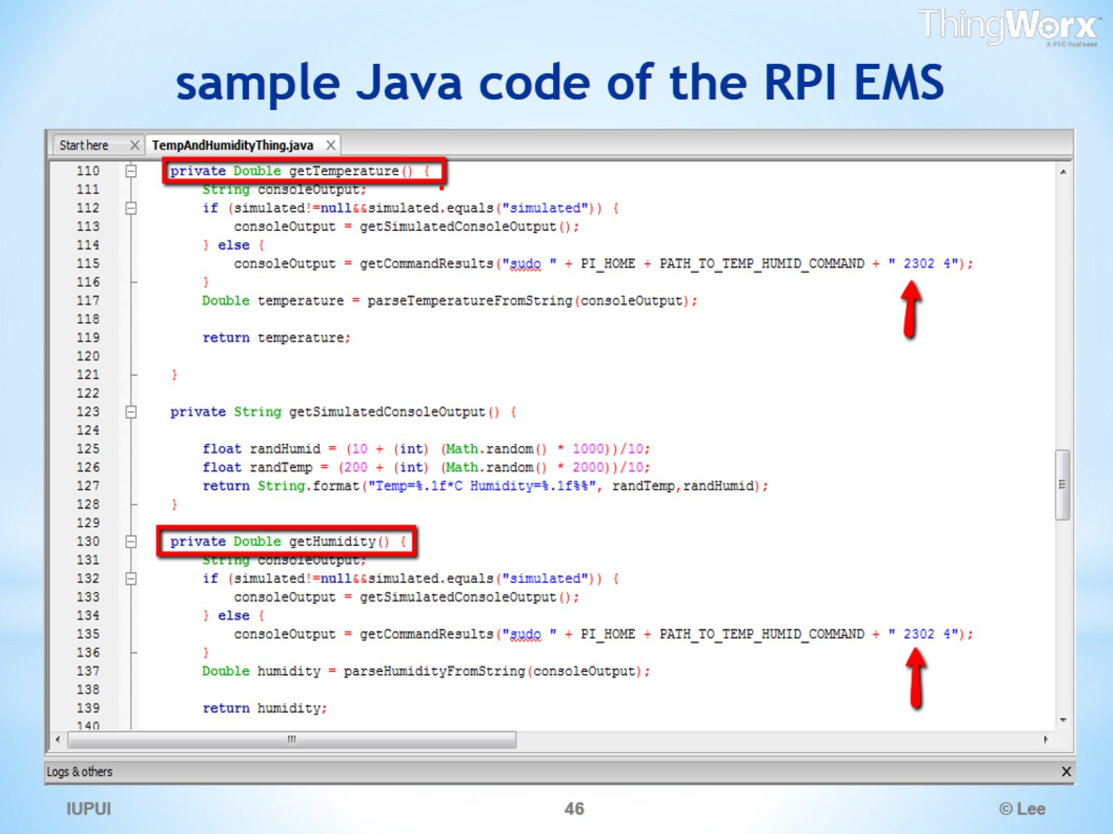
sample Java code of the RPI EMS

Slide 47
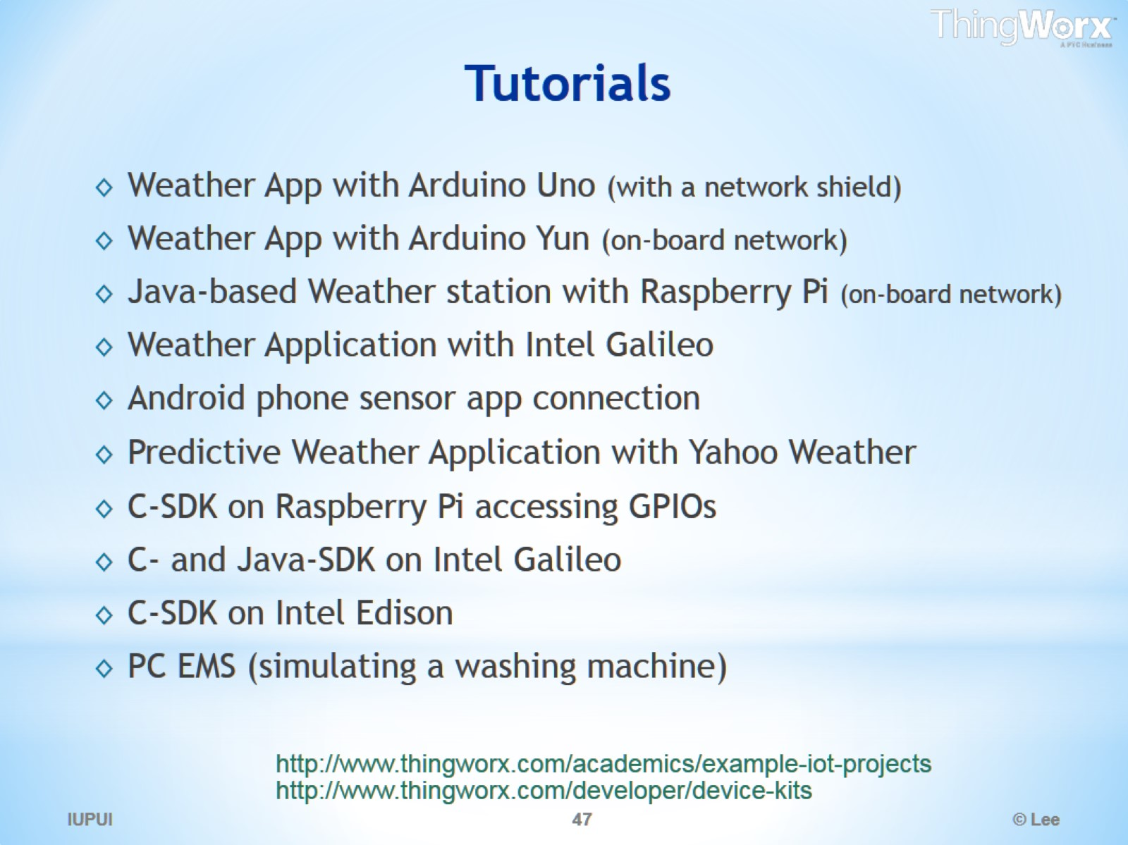
Tutorials

Slide 48
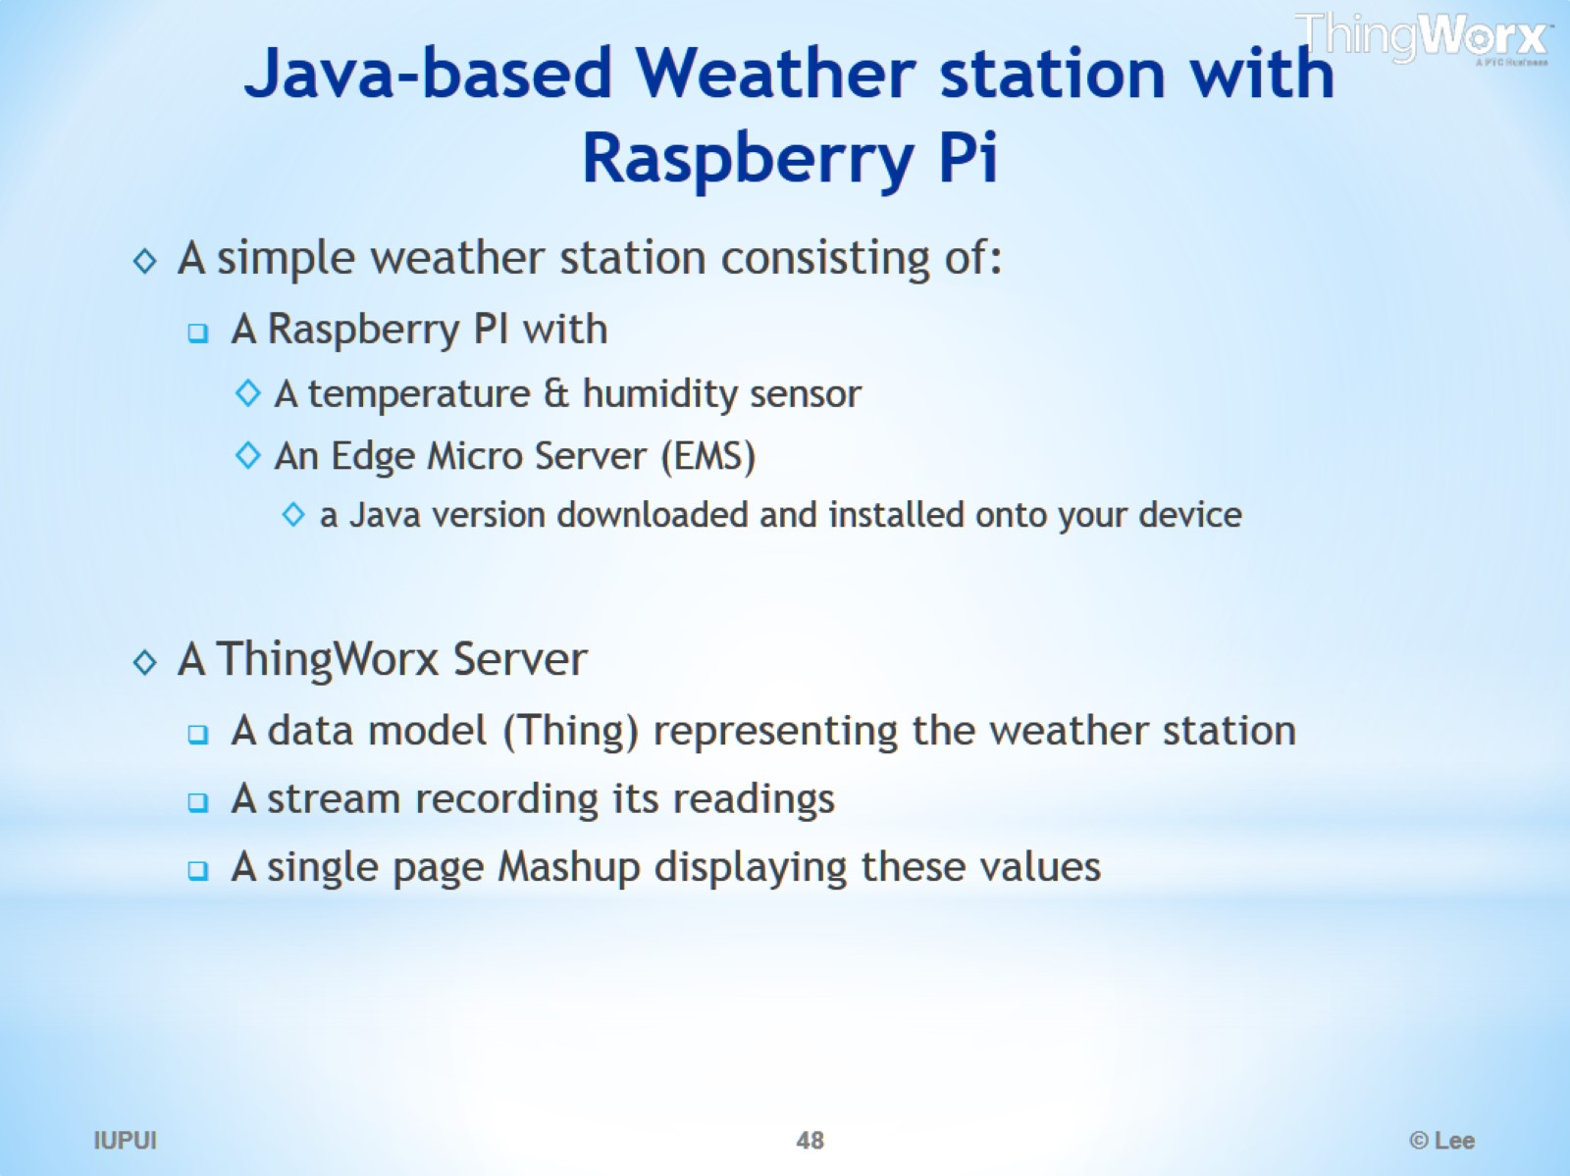
Java-based Weather station with Raspberry Pi

Slide 49
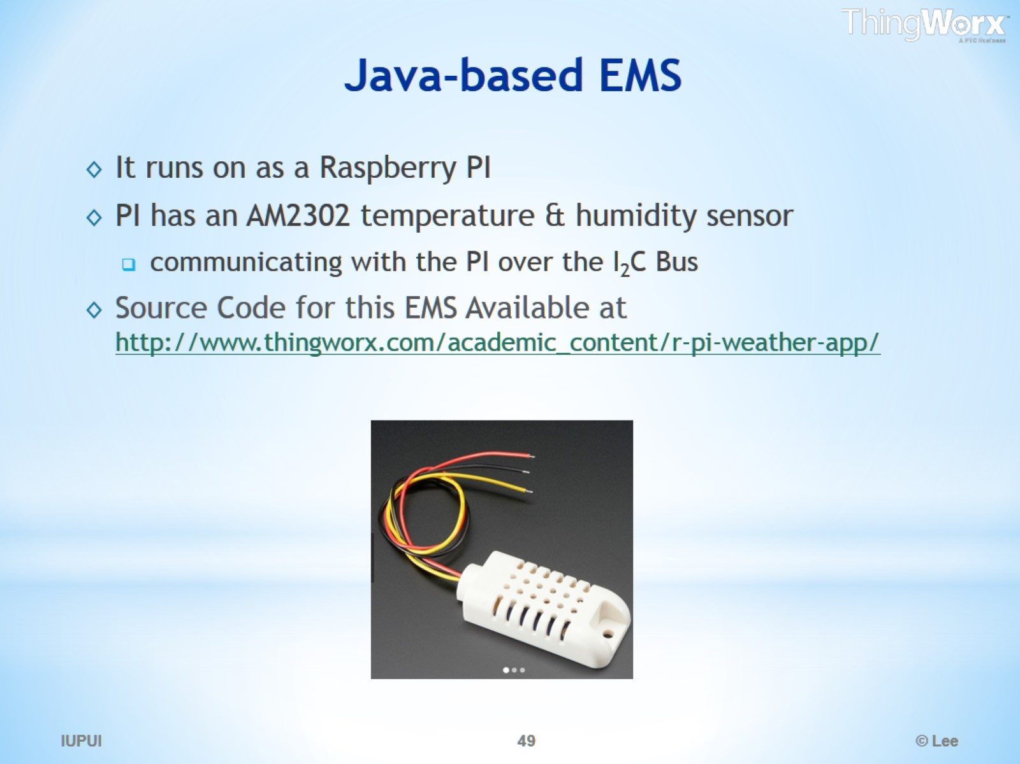
Java-based EMS

Slide 50
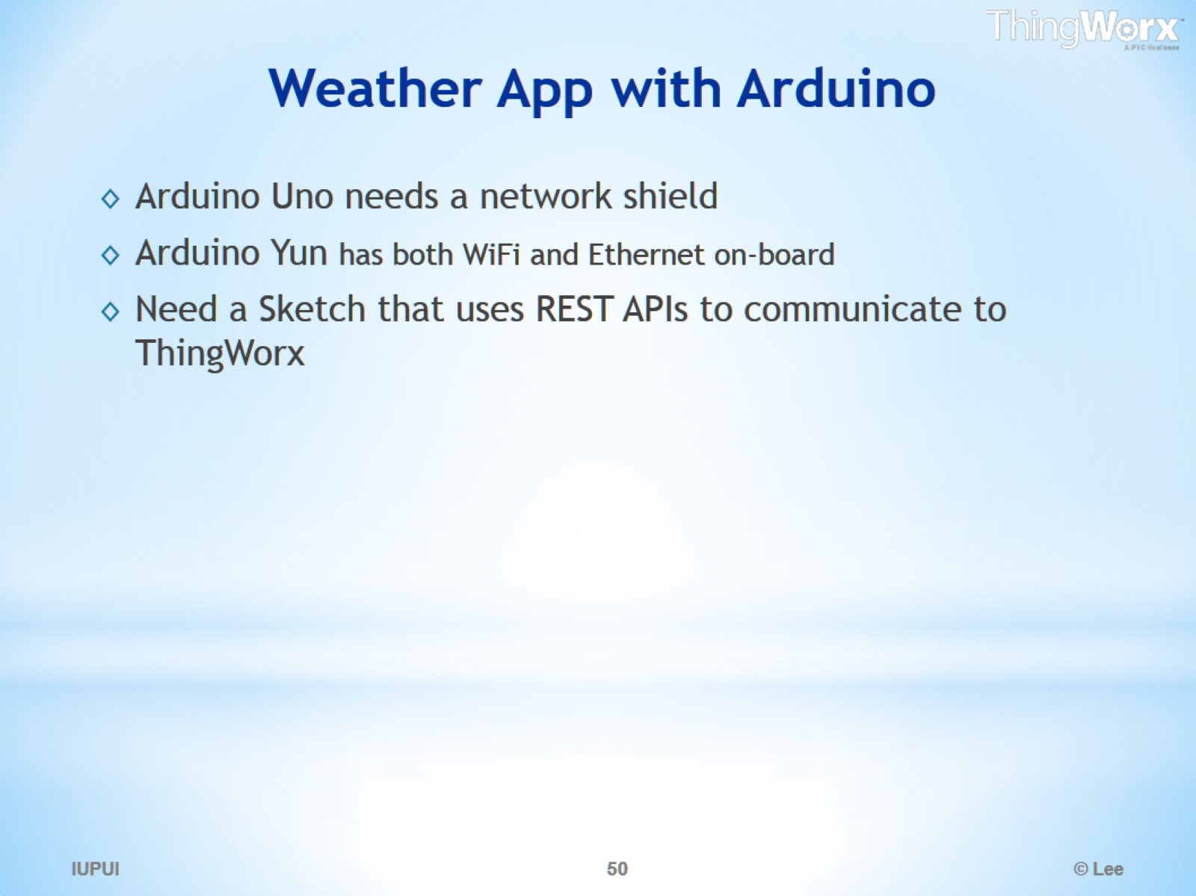
Weather App with Arduino

Slide 51

Additional Tutorials

Slide 52

The Composer a web-based modeling & development environment

Slide 53

Creating a Mashup using the Composer

Slide 54

Applications

Slide 55

Applications

Slide 56

Manufacturing

Slide 57

ThingWorks - Smart Buildings

Slide 58

ThingWorx - Machine2Machine

Slide 59

ThingWorkx - Complex Machinery

Slide 60

ThingWorkx - Transportation

Slide 61

Smart Traffic Monitoring & Public Safety

Slide 62

Smart Agriculture

Slide 63

Smart Agriculture

Slide 64

Water Monitoring

Slide 65

Structural Monitoring

Slide 66

Connected Vehicles

Slide 67


Slide 68


Slide 69


Slide 70


Slide 71


Slide 72


Slide 73


Slide 74


Slide 75


Slide 76


Slide 77


Slide 78


Slide 79


Slide 80


